Slide 1


We Are Hinchingbrooke

Slide 2
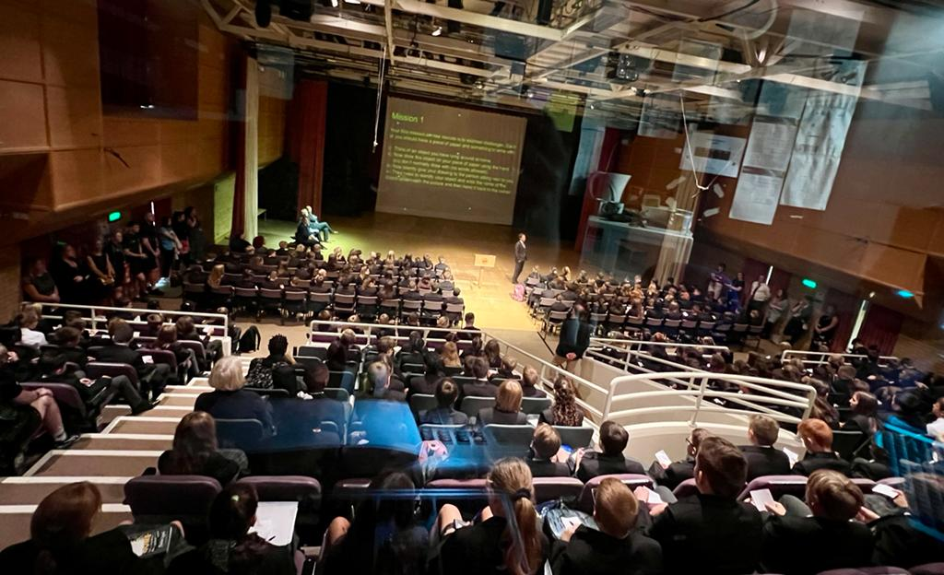
ADD YEAR 7 PHOTO FROM FIRE DRILL

Slide 3
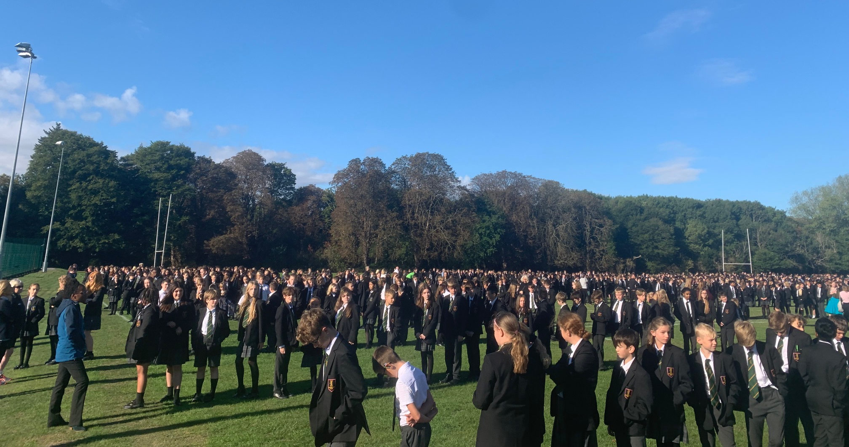

Slide 4
HBK Meet the Tutors Event 2022!
1. SEND and ‘Basecamp’ - Mrs Harris and Mr Parker
2. Attendance - Mrs Benjafield
3. Teaching and Learning - Mrs Solvar-Isida
4. Start of Year 7 - Mr Milner

Slide 5

SEND
Nurture and Nurture Lite Lessons
The Haven
Referrals
Interventions
Teaching Assistant Hub

Slide 6

SEND
In class support/Pen Portraits
Key workers
Transitions
Access Arrangements

Slide 7
"Attendance is the single most
influential factor in respect of
a student's learning outcomes and achievement"

Slide 8
Section 444 Education Act 1996
'regular' school attendance
is defined as
‘100%, unless there are exceptional or unavoidable reasons for absence’.

Slide 9
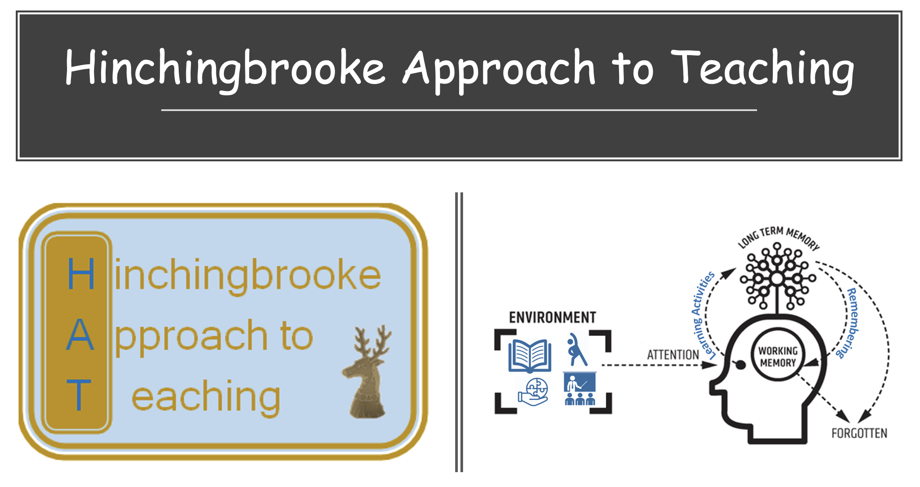

Slide 10
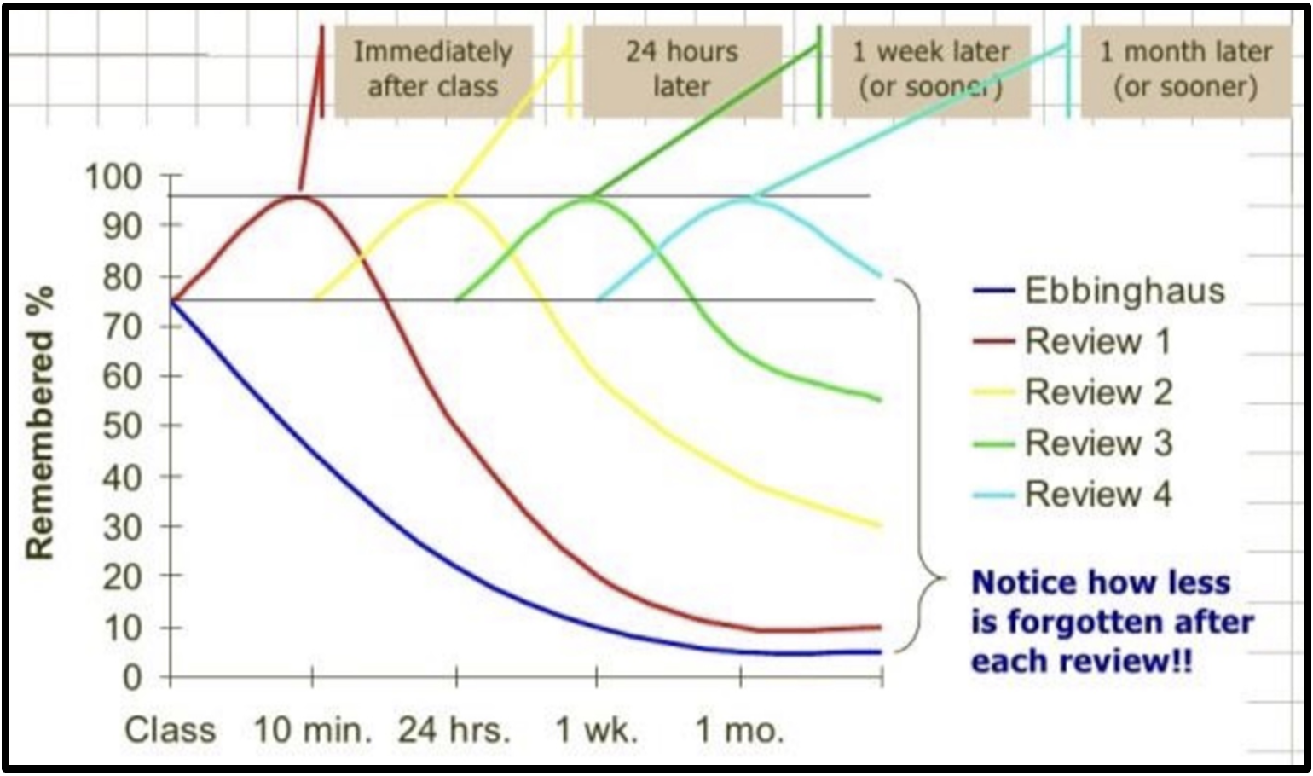
This is how we learn and remember

Slide 11

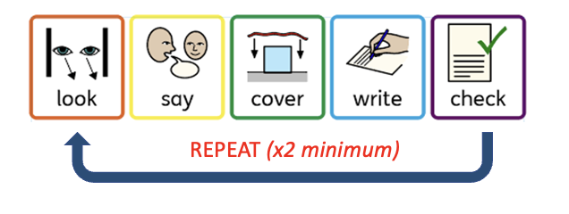


This is how we learn and remember

Slide 12

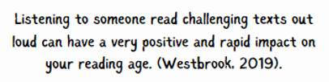
Guided Reading

Slide 13







Guided Reading Tutor Programme

Slide 14
First impressions of the school
Happy & nervous
Thought I’d get lost more than I did
The teachers are really nice
It’s massive!
The uniform makes me feel grown up
Teachers give you independence
I really like the competitive sports

Slide 15
First impressions of your form group
Lots of different characters so lots of friends to make
We were shy, but soon started talking
It feels like a team
A mini-family
I have made lots of new friends
My tutor is amazing
We all encourage each other so much

Slide 16

Worries and Concerns

Slide 17
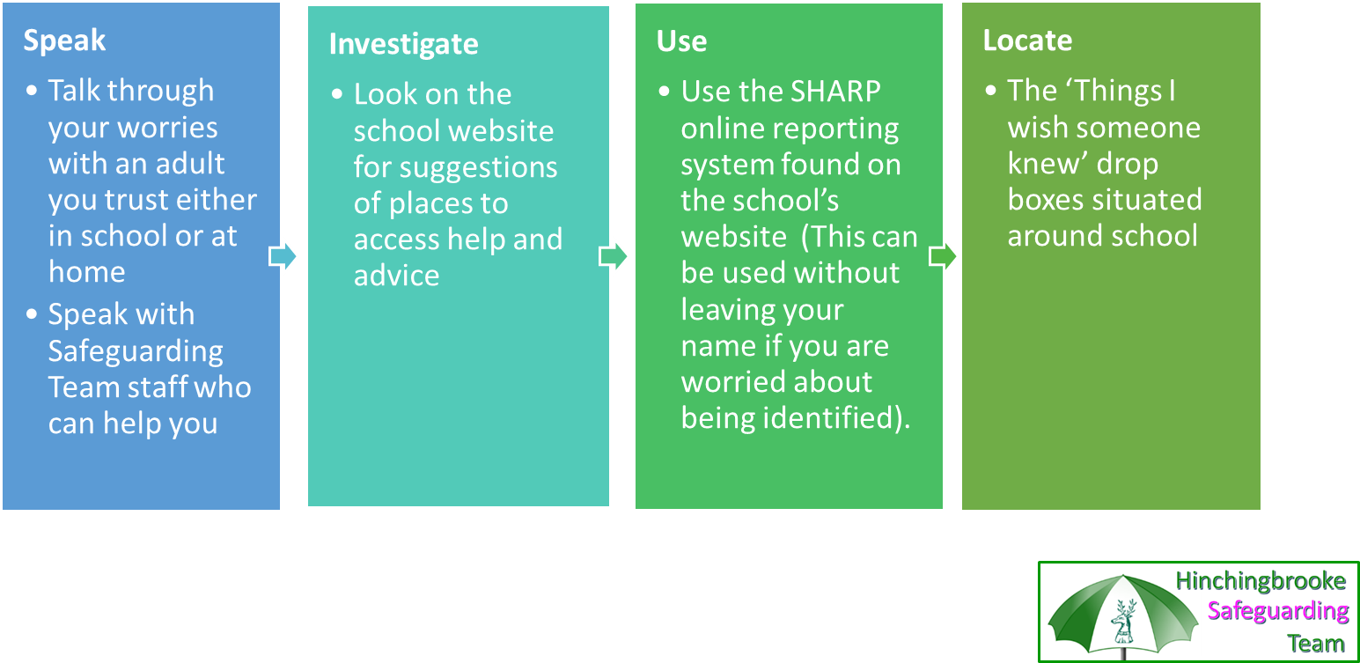
What can I do? I need support or I'm worried about someone else

Slide 18
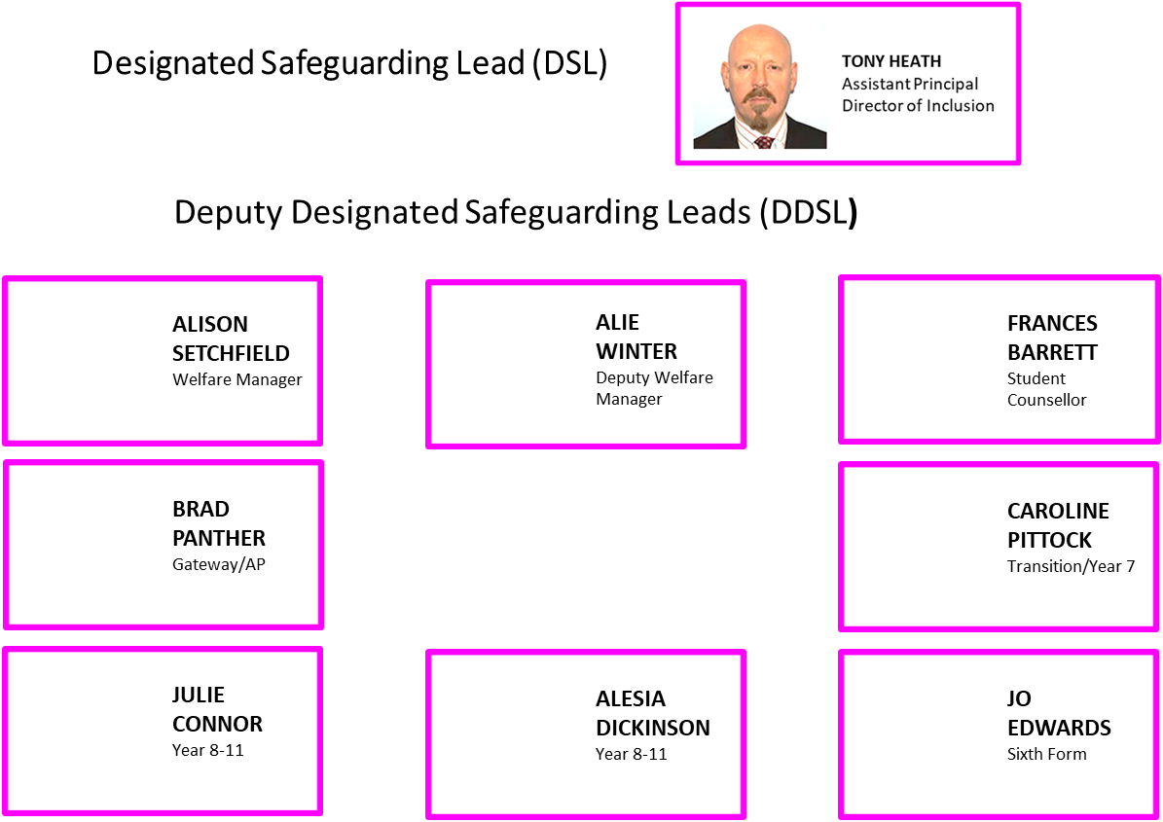
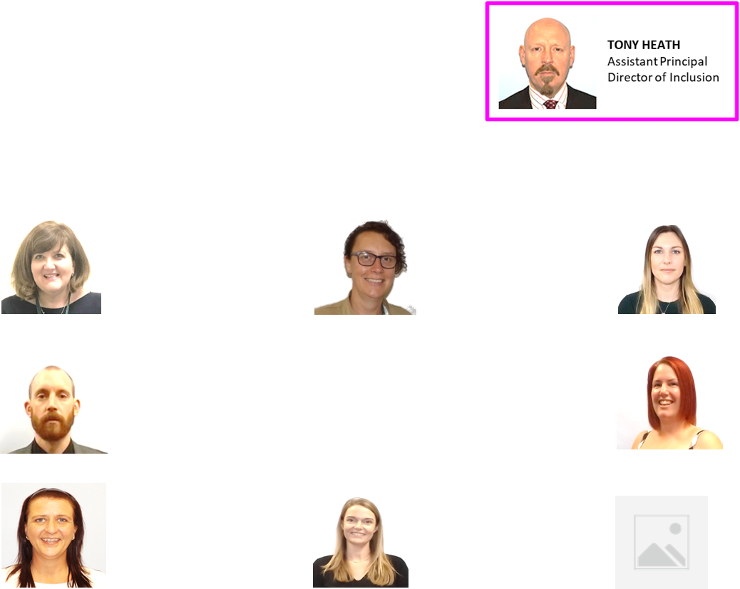


Slide 19
Form | Tutor | Room
7M1 | Mrs Rider | 12
7M2 | Miss Longstaff | 7
7V1 | Mr Styler | 2
7V2 | Mrs Bowman | 18
7W1 | Miss Shutt | 20
7W2 | Miss Toone | 21

Slide 20




