Slide 1


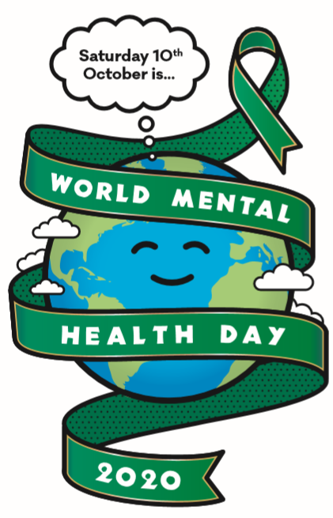

How kind are you?
Evidence shows that helping others and showing kindness can have a positive effect on your own mental health and wellbeing…
What random acts of kindness can you think of?
Make a cup of tea for a family member
Do something for charity
Compliment somebody
Say hello to people you see every day and ask how they are doing?
Reach out to someone you haven’t spoken to in a while
Post a positive comment on a blog
Be a good and helpful friend
Help with household chores
Smile at people
Doing Good Does You Good

