Slide 1





PiXL Apps For Success
Mr Woodfine
Lead Practitioner in Mathematics
PiXL App Developer

Slide 2
Who are PiXL?
PiXL are a London based company who network with teachers across more than half of all secondary schools in the country. They take the best practice seen in schools are share it across the network.
From Hinchingbrooke they have taken the power of apps and the influence they can make on developing independent learners.

Slide 3
So what apps are there?
PiXL Maths App
PiXL Literature App
PiXL Geography App
PiXL History App
PiXL Times Tables App
PiXL Vocabulary App

Slide 4
So what sets them apart?
The apps have the core PiXL beliefs built into the heart of each of them. The apps focus on Diagnosis, Therapy and Testing.
The apps provide clear cut guidance about what a student is at and where they need to move their learning.
The apps contain everything that a student needs to revise their knowledge of set units of work.

Slide 5
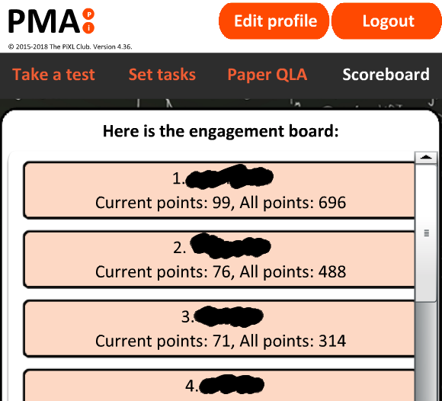
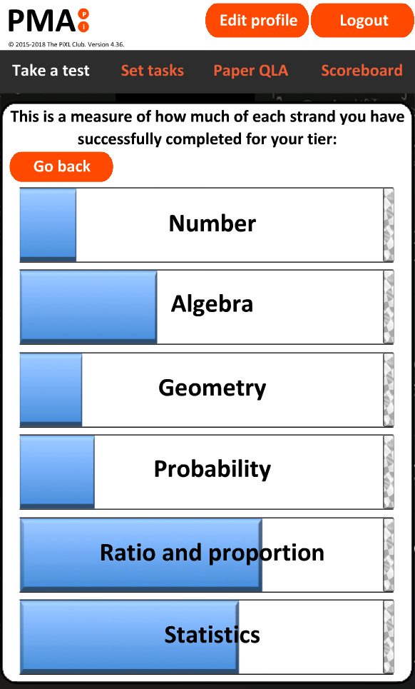
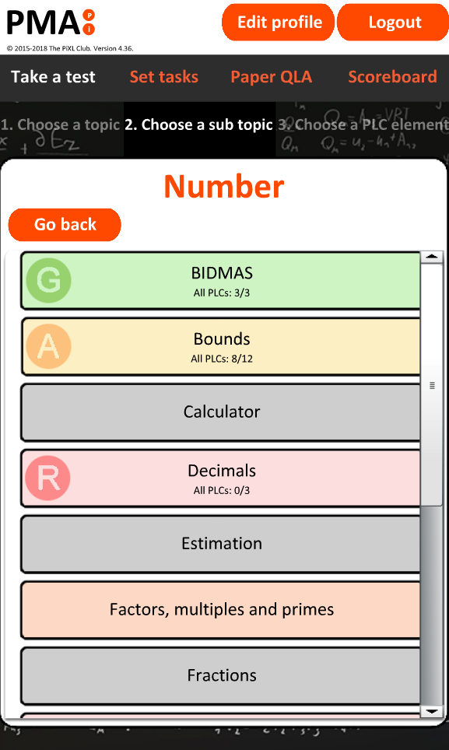
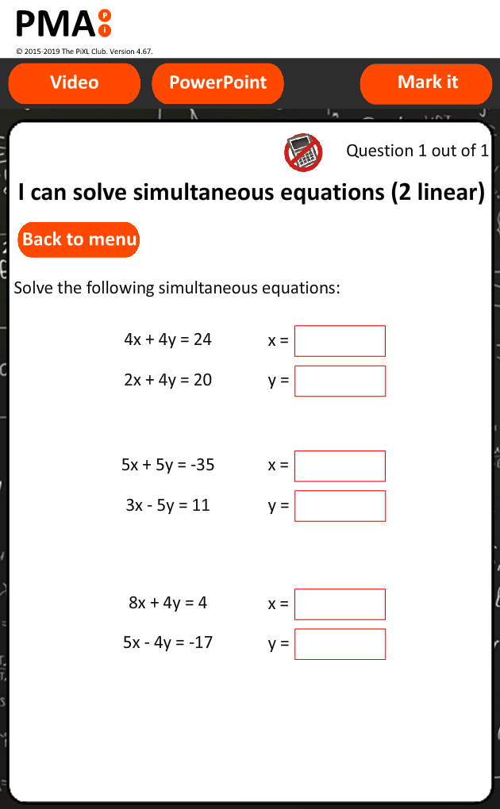
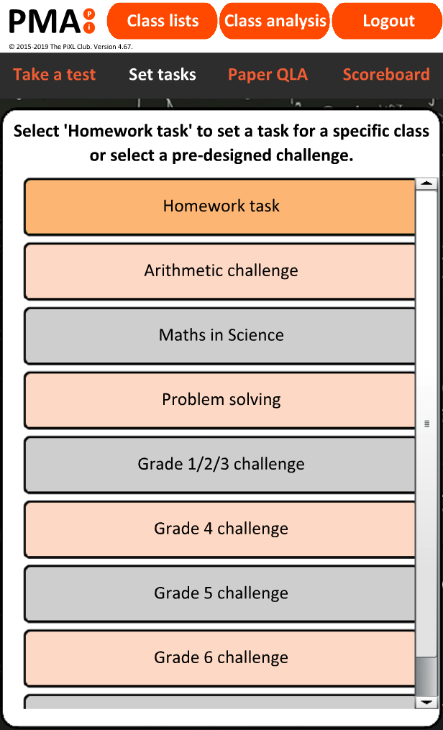

Slide 6
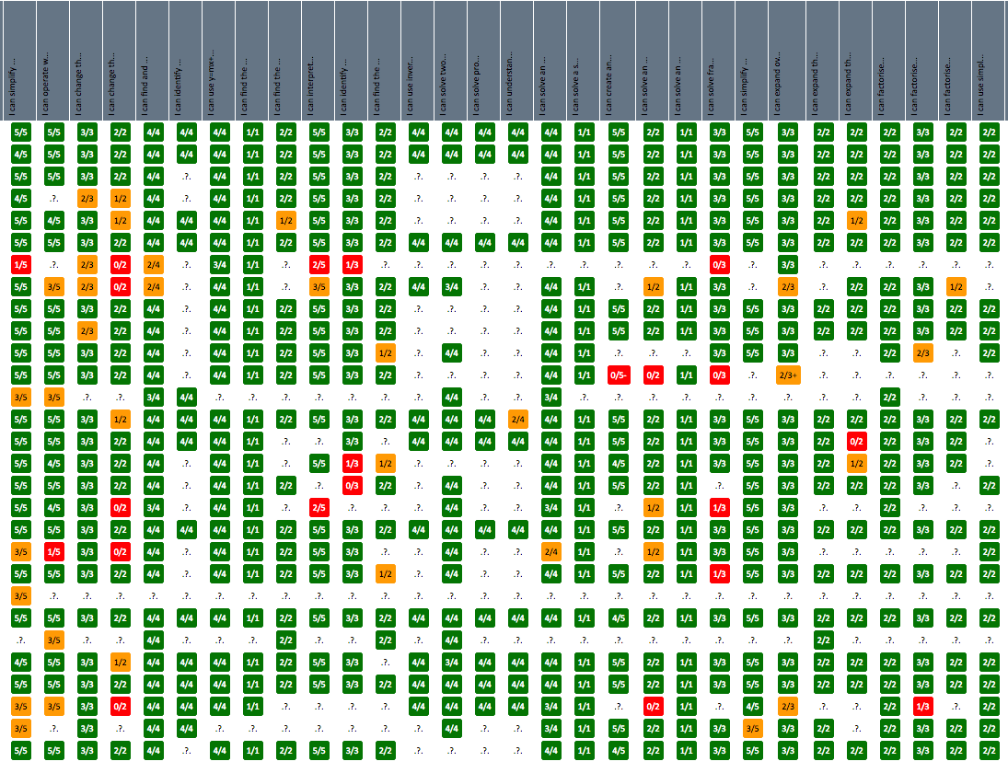


Slide 7
Show me the evidence!
In 2011 we introduced an early incarnation of the app to Hinchingbrooke following a devastating set of results. Our department achieved 57.1% A*-C. The app focused on generating skill based knowledge. As a by product, students were able to vocalize their needs using key terms from the app.
The app proved to be a huge success with our students. It was a free resource that meant they could practice their Maths at any time and at their own pace.
In 2012 our results jumped to 72.8% which was our highest set of results and have since continued to grow from strength to strength.

Slide 8
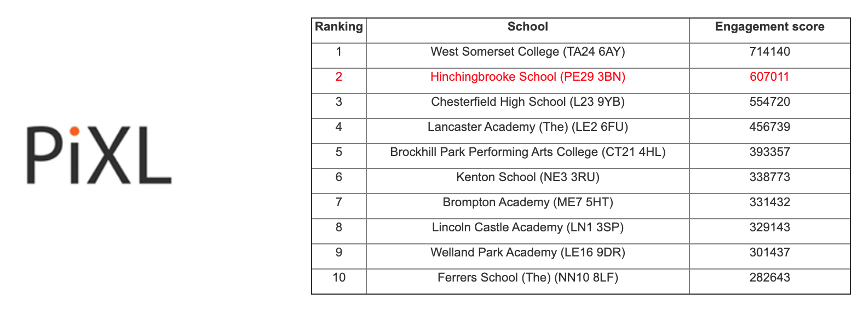

Slide 9
How do students login?
School ID: 22203
Username: Surname followed by first initial
Password: Please ask your teacher if you are unsure

Slide 10
How do we as parents fit in?
Encourage your son/daughter to use the app on
top of any other homework.
Little and often is key to overall retention of information.
If you are teaching your son/daughter a particular skill, try and use the techniques shown in the videos/PowerPoints.

Slide 11
Content in more detail: Maths
https://mathsapp.pixl.org.uk
Everything!!!!
All of the following strands are covered at both the higher and foundation tiers:
Number
Algebra
Ratio and proportion
Geometry and measure
Statistics
Probability

Slide 12
Content in more detail: Literature
https://englishapp.pixl.org.uk
The following texts are covered within the app:
Animal Farm
Blood Brothers
The Curious Incident of the Dog
Frankenstein
Great Expectations
Henry V
Heroes
Hobson’s Choice
Jane Eyre
Jekyll and Hyde
Journey’s End
Julius Caesar
Lord of the Flies
Macbeth
Much Ado About Nothing
Never Let Me Go
Othello
Pride and Prejudice
The History Boys
The Merchant of Venice
The Sign of Four
The Tempest
To Kill A Mockingbird
And I have run out of space….

Slide 13
Content in more detail: History
https://historyapp.pixl.org.uk
The following units have been filtered for our school and are available within the app:
Cold War
Medicine
Norman England
Western Front

Slide 14
Content in more detail: Geography
https://geographyapp.pixl.org.uk
The following units have been filtered for our school and are available within the app:
Climate Change
Economic Change/Development
Ecosystems
Natural Hazards
Weather Hazards
Resources – Food
Resources – Water
UK Physical Landscapes – Coasts
UK Physical Landscapes – River
Urban

Slide 15
Content in more detail: Vocabulary
https://vocab.pixl.org.uk
General vocabulary building blocks
Words for…
Command words
Subject specific words

