Slide 1
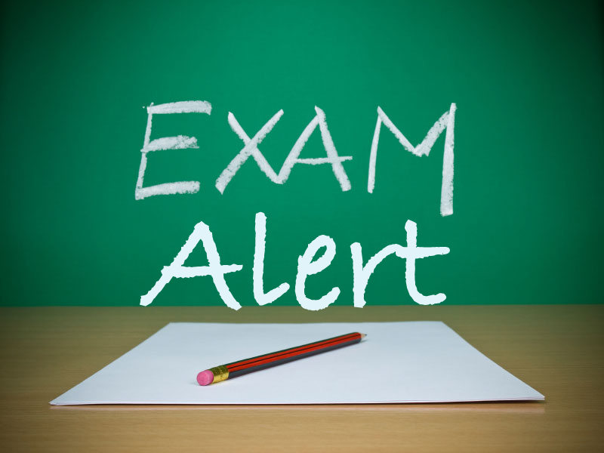
Aqa a religious studies gcse exams
Paper 1: Monday 11th May 2020
Paper 2: Tuesday 18th May 2020

Slide 2







      WHAT IS ON THE EXAM?
Paper 1: Christianity Beliefs, Christianity Practices and Buddhism Beliefs, Buddhism Practices
Paper 2: Relationships (Sets 4-6 only), Religion and Life, Existence of God (Sets 1-3 only), Religion, Crime and Punishment, Religion, Peace and Justice

Slide 3
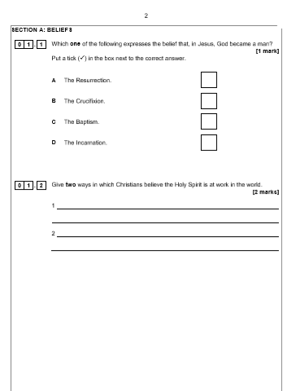
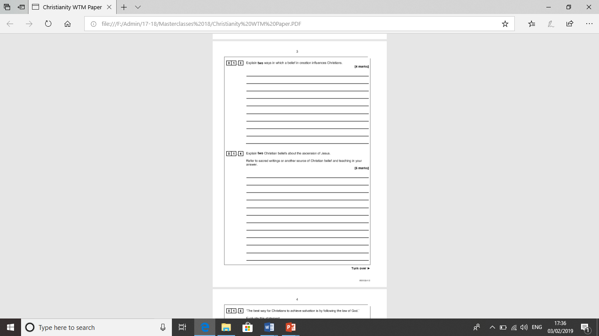
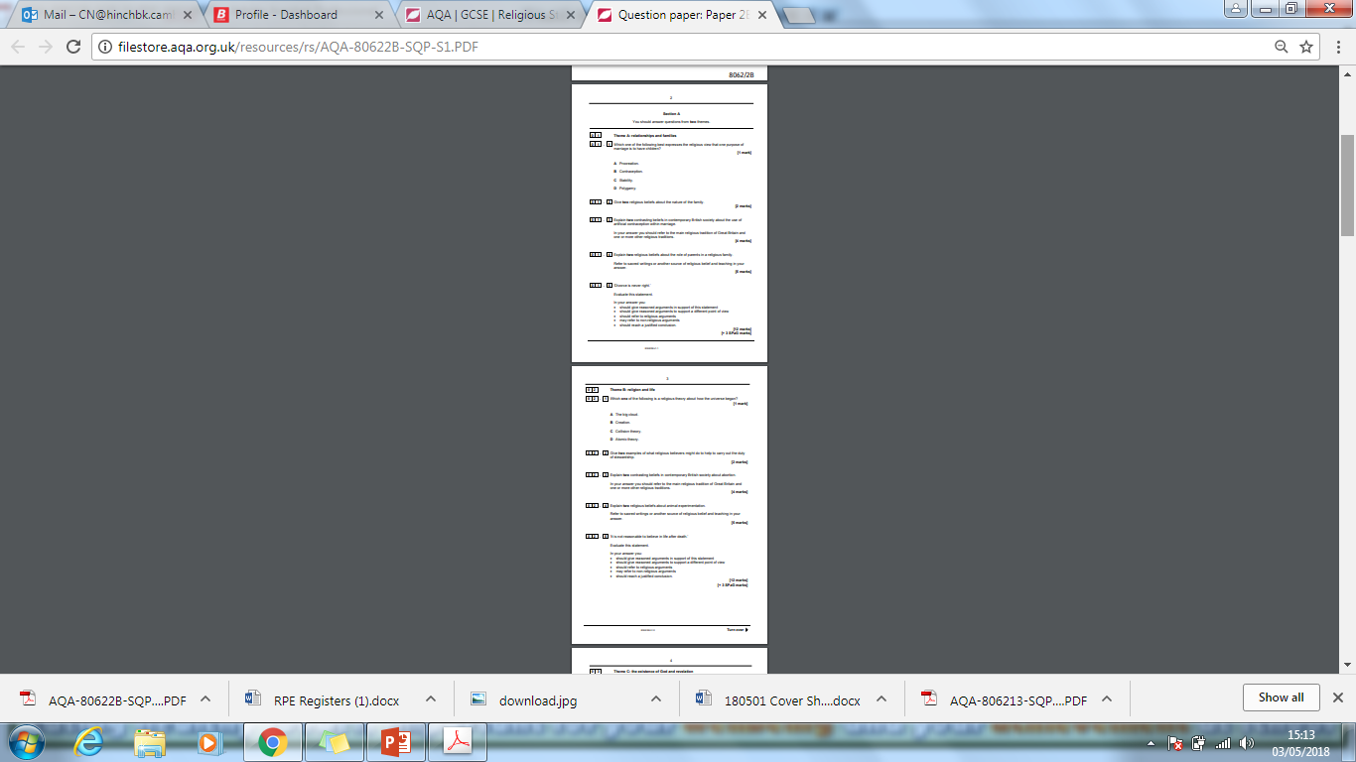
      WHAT DO THE PAPERS LOOK LIKE?
For Paper 1, students will have TWO booklets given to them: one for Christianity and one for Buddhism
They must answer ALL questions in both booklets on the lines provided
For Paper 2, students will be given a question booklet with 6 different units in it but they must only answer the questions for the 4 units they have studied
They should answer questions in the lined booklet

Slide 4

      HOW MUCH TIME DO STUDENTS HAVE?
Both exams are 1 hour and 45 minutes long
As there are 4 sections in each paper, students should spend about 25 minutes on each.
So for Paper 1 this means that they should spend 50 minutes on the Christianity paper and 50 minutes on the Buddhism paper to ensure they answer all questions in the time allowed

Slide 5
      WHAT QUESTIONS WILL THE EXAM ASK?
All sections that students have to answer in the exam will have the following questions:
1 mark question – this is multiple choice and will test the knowledge of a key fact
2 mark question – students have to ‘give’ or ‘name two’, this should be in the form of bullet points only
4 mark question on Paper 1 - this will ask students to explain two ways in which a Christian belief influences their behavior, this should be in the form of two short paragraphs
4 mark question on Paper 2 – this will ask students to give two contrasting or similar beliefs on a topic, one of their two short paragraphs should refer to Christianity

Slide 6
      WHAT QUESTIONS WILL THE EXAM ASK?
All sections that students have to answer in the exam will have the following questions:
5 mark question – this is very similar to a 4 mark in that students will have to explain two beliefs about a topic, one of the explanations must include a religious teaching. This could be in the form of a quote, paraphrase or reference to any religious belief.
12 mark question – requires students to evaluate a statement, giving reasons for and against, answers should be written in the DREARER formula below:
Paragraph 1: Disagree with Religious reasons and Evaluation (This is a strong/weak argument because…)
Paragraph 2: Agree with Religious reasons and Evaluation (This is a strong/weak argument because…)
Paragraph 3: Reach a conclusion (In conclusion, I agree or disagree because…)

Slide 7
      HOW CAN MY CHILD REVISE FOR RPE?
Create their own revision guide
Mind maps and connection maps
Make their own flash cards
Peer mark with a friend
Make their own podcasts
Watch videos on Youtube
Testing of key words and quotes with family/friends
Kahoot quizzes
Practice exam questions
Make their own exam question guide

Slide 8
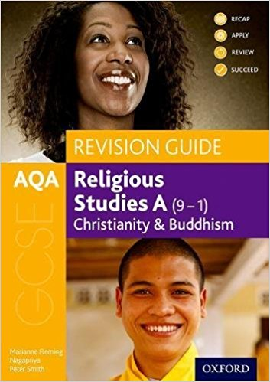
      WHAT RESOURCES ARE AVAILABLE TO MY CHILD TO AID WITH THEIR REVISION?
OUP Revision Guide, available for £9.99 on Amazon
Youtube Podcasts – ‘World Faiths’, ‘Edu Mania’
Doddle – more revision materials will continue
to be added over the coming months
Revision sessions on Wednesdays after school –
students pick and choose depending on the
topics they believe they need to revise
PLCs and Quote Booklets provided
Practice questions and papers provided

Slide 9

      HOW CAN I HELP MY CHILD REVISE?
Provide your child with a quiet space in which they can work away from distractions (particularly the TV and their mobile phones!)
Help them to produce a revision plan/timetable
Encourage your child to practice exam
questions in timed conditions
Allow them to put posters on the walls!
Always ask ‘why?!’
Encourage them in their 100 Days
Challenge

Slide 10

      WHAT IS THE 100 DAYS CHALLENGE?
In the 100 days leading up to the Paper 2 exam (starting Friday 8th February) we are challenging students to complete 1 exam question a day
These will be available on Doddle from Thursday
For every 20 they complete students will earn an entry into a prize draw
We are also challenging parents!
We will send a list of key words/quotes
home via Parentmail on Thursday
Please test your child on the word/quote
given each day

