Slide 1
KS4 Success Evening
Mrs C Olsen
Science

Slide 2
Science options
All students are taking AQA GCSE Science
Exam dates:
Subject | Paper 1 | Paper 2
Biology | 12th May | 1st June
Chemistry | 14th May | 10th June
Physics | 20th May | 12th June
 | Before ½ term | After!

Slide 3
Exam Content
All Combined (Trilogy) papers are 1hr 15mins.
All Triple papers are 1hr 45mins.
All papers have particular units assigned to them.
Details of the content can be found in the course specification.

Slide 4
Exam content
Subject | Paper | Content
Biology | 1 | Cell Biology; Organisation; Infection and response; and Bioenergetics
Biology | 2 | Homeostasis and response; Inheritance, variation and evolution; and Ecology
Chemistry | 1 | Atomic structure and the periodic table; Bonding, structure, and the properties of matter; Quantitative chemistry; Chemical changes; and Energy changes.
Chemistry | 2 | The rate and extent of chemical change; Organic chemistry; Chemical analysis; Chemistry of the atmosphere; and Using resources.
Physics | 1 | Energy; Electricity; Particle model of matter; and Atomic structure.
Physics | 2 | Forces; Waves; and Magnetism and electromagnetism

Slide 5
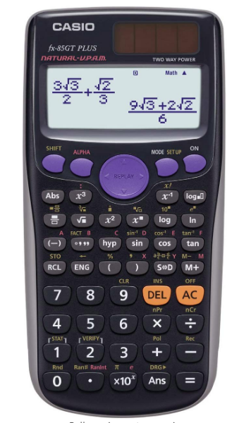
Calculators
All of the Science papers have a
Mathematical aspect to them.
All students need one and they need to
have it in school
Casio fx-83GT PLUS
Get one now so they can practice using it.

Slide 6
Learn the Content
At this stage students should be preparing themselves by learning the required content for the 3 subjects.
  Mind maps
  Fact cards
  Summary notes
But please remember, creating these is not the end of the story! Students must review their notes repeatedly.

Slide 7
Learn the Content
2 sessions of revision time per week on each subject.
Triple maybe more.
When, in a review session, the student can recall all the information in the notes, it is time to start applying their knowledge.

Slide 8
Required practicals
All three Sciences have a set of required practicals which the students should have a good working knowledge of.
They should be able to answer questions such as:
What are the variables in this investigation?
What is the method for this investigation?
What sources of error might there be for this investigation?
What is the expected result for this investigation?

Slide 9
Past Exam Paper questions
These can be a really useful after the knowledge has been learned.
They can be used in a variety of ways:
  As a test of knowledge
  As a review of knowledge
  As an exam technique refiner

Slide 10
Past Exam Paper questions
These can be found on the AQA website.
Google AQA, then follow the links through;
  Subjects
  Science
  GCSE
  Either Trilogy or the subject
  Assessment resources
Here you will find the specimen papers with mark schemes provided by the exam board for help with preparing students.

Slide 11
Other resources
CGP revision guides are very good revision guides and they are the ones we use in school.
PLCs which are on Doddle
Mobile phone apps can be used to revise.
Kerboodle text book and revision resources are available to all GCSE students:
  Username, eg colsen
  Password, the same
  Institution code gxz1.

Slide 12
Other resources
https://www.senecalearning.com/
https://www.physicsandmathstutor.com/
www.bbc.co.uk/bitesize
www.doddlelearn.co.uk has resources specific to our revision program in lessons.
YouTube; in particular “free science lessons” which are excellent for short, sharp reviews and summaries of the required practicals

Slide 13
Physics
Learn the equations. Last year, paper 1 contained 34 marks which students could only access if they knew their equations. The sooner they start, the better.
Follow the “six steps to answer equations” and write out their workings in full.This method is designed to ensure they get as many marks as possible even if they can’t fully answer the question.
Use their calculator for all mathematical working out!

Slide 14
Biology
Learn the key words! Create a glossary or find one on Doddle and learn the definitions.
Learn the key calculations for Biology: calculating percentage change, magnification calculations, areas of shapes.
Be confident in describing data on a graph, which means “say what you see…”. Expand that to explain why the data, looks like it does …

Slide 15
Chemistry
Students will be given a periodic table in the exam. They need to know the properties of Group 1, 7 and 0. They need to know what the atomic and mass numbers mean and how to use them.
Students should know how to produce dot and cross diagrams to represent atomic structure.
Students should know how to calculate rate of reaction.

Slide 16
Final point …
1) Find a space with no distractions
2) Choose a topic – ideally based on analysis of strengths and weaknesses (pick a weak one)
3) Read the spec for that topic to give an overview
4) Watch a ‘free science lesson’ video on YouTube to get in the right frame of mind
5) Find the appropriate bank of questions on Physics and Maths Tutor . com and try 2 or 3 questions
6) Mark the questions
7) Maybe watch a different vid (primrose kitten for example)
8) Find different questions (same topic)
9) Mark again
10) Stop – Feeling confident about having done enough for one evening is key – This is why writing notes for hours on end is counter-productive.

