Slide 1



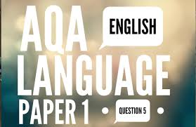



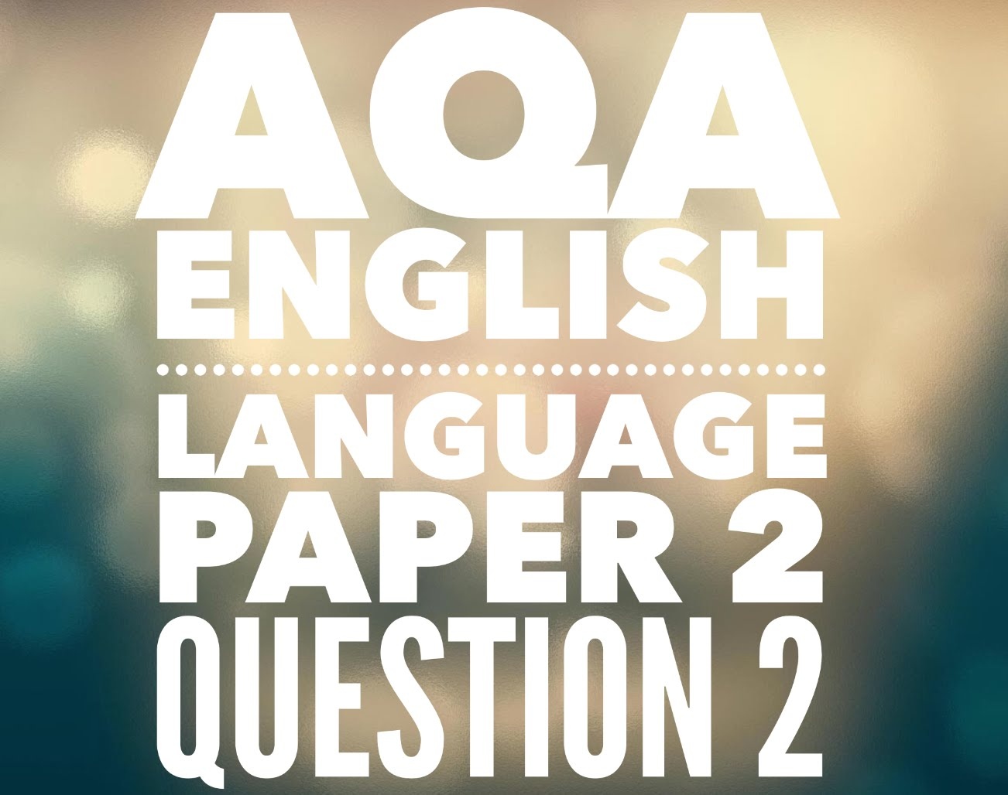
Welcome!
Miss S Spikesley
sls@hinchbk.cambs.sch.uk

Slide 2




The best things in life come in envelopes…

Slide 3
The best things in life come in envelopes…

Slide 4
GCSE ENGLISH COURSE OUTLINES
ENGLISH LANGUAGE | ENGLISH LITERATURE
Paper 1 - 1hr 45minutes Explorations in Creative Reading and Writing Reading – one literature fiction (40 marks) -1 short form question -2 longer form questions -1 extended question Writing – descriptive or narrative (40 marks) | Paper 1 - 1hr 45minutes Shakespeare and the 19th-century novel (64 marks) Section A – Romeo and Juliet or Macbeth students need to write in detail about the extract and then the play as a whole. 4 marks awarded for spelling, punctuation and grammar. Section B – Jekyll and Hyde or A Christmas Carol. Students answer in detail about the extract and then the play as a whole.
Paper 2 – 1hr 45minutes Writers’ Viewpoints and Perspectives Reading – two linked non-fiction texts (40 marks) -1 short form question -2 longer form questions -1 extended question Writing – extended writing task to present a viewpoint (40 marks) | Paper 2 - 2hr 15minutes Modern texts, Power and Conflict poetry and unseen poetry (96 marks) Section A – An Inspector Calls students answer one essay on either theme or character Section B – Power and Conflict students compare one named poem from P&C anthology with another of their choice Section C – students answer a question on one unseen poem and one question comparing this poem with a second unseen poem
Non-exam assessment: Spoken Language -presenting -responding to questions and feedback -Use of Standard English

Slide 5


But that’s not all…
The National Changes to English…
NO tiers of entry- all students take the same examinations regardless of ability across the 9-1 grade range
More reading and harder vocabulary- all papers require students to read and understand extracts quickly and they contain increasingly difficult vocabulary
Better quality writing- all papers, across both Literature and Language, also require students to write better quality responses to show their understanding. This means that students need to use better vocabulary and sentence types to allow themselves to convey complicated ideas.

Slide 6
“you can’t revise English”

Slide 7


Slide 8

What support are the students getting in school?
Quality first teaching and support in the classroom
Additional support from TAs and specialists for students who require support
Bespoke revision classes on Mondays after school
Word of the day in form time- drip feeding new vocabulary each day!
Directed revision tasks set for private study at home and in form time including…
Revision set on Doddle
Seneca learning log in
PiXL Literature App log in
Printed PiXL independence booklets- one for every unit of study!
Past paper questions
Thinking Hard style activities
TRIPS/ events to vary revision

Slide 9

How can you support your child at home?
We promote SMART revision strategies vital to success-
Check that your child is logged in to the PiXL Lit App and Seneca Learning
Ask your child about their private study/ word of the day in form time
Purchase some of the suggested revision materials - include workbooks so that students are doing the activities
Encourage attendance at revision classes on Mondays
Promote and partake in short snappy activities for content revision
Encourage the use of colour, image and language to maximise long term retention
Test your child on their quotations often to check knowledge is embedded – continue to revisit this

Slide 10
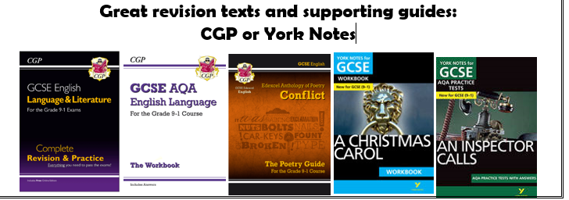
Promote the different support materials available- videos too!
SUMMARISE, DEDUCE and EVALUATE activities at every opportunity - i.e “Summarise the plot of Jekyll and Hyde for me…” Create opportunities to talk about English
Promote reading as far as possible- shorter snappier non-fiction articles as well as ambitious fiction
Encourage timed examination pieces closer to the examination period- rehearsing hand written responses is vital to student success
Encourage students to read creative writing aloud to you – this improves editing skills
Encourage breaks in revision (typically a short break after a 45 min revision session)
Praise your child when they do any of the above!

Slide 11

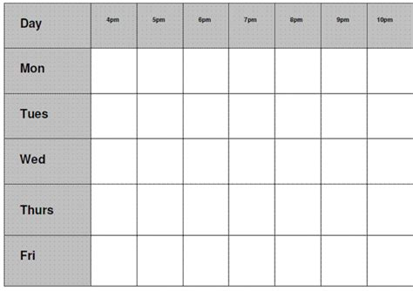
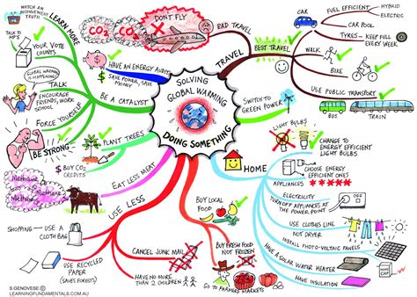
Tools you should use…

Slide 12

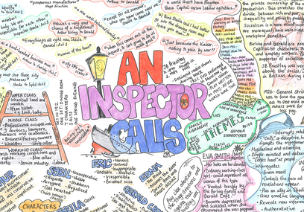

What you can do now
English
1) Start revising quotes now!
post it notes in strategic places!
Look, cover, write
Annotate the lists we give you
Get your parents to test you!
2) Use a variety of revision techniques!
Mr Bruff videos
Akala videos
Resources on the school website
Onedrive
Past paper questions
4) Make use of your old notes!
Re- PLC!
RAG the pages of your exercise book
Make use of your revision guides
Create your own exam questions based on previous answers
Improve one of your previous responses
Rip out pages of old books and stick them up around the house
3) Remember the research…
Memory = image+ colour + text
Use both sides of your brain!

Slide 13



