Slide 1
Top Tips For Maths
Mr Steed and Mr Boyle

Slide 2
Top Tips for Maths
Making the most of your lessons JGS
Curriculum MSB
Assessment JGS
Setting JGS
Resources MSB
Exams MSB

Slide 3

Making the most of your lessons

Slide 4
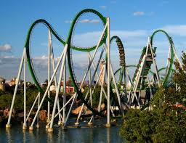
Making the most of your lessons

Slide 5

Making the most of your lessons

Slide 6

Making the most of your lessons

Slide 7

Making the most of your lessons

Slide 8
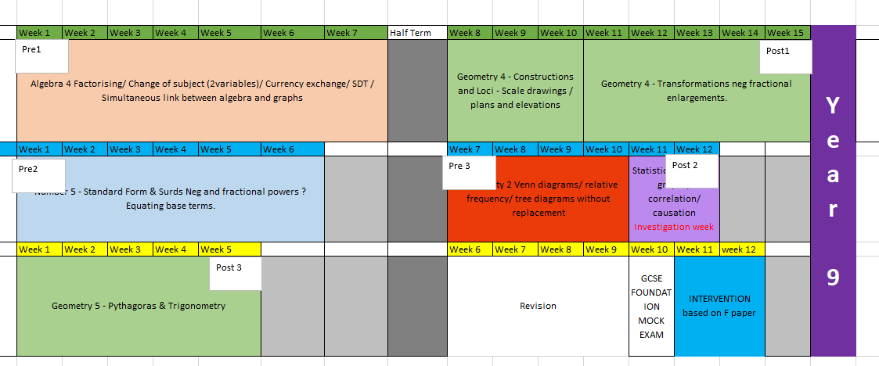
Curriculum

Slide 9
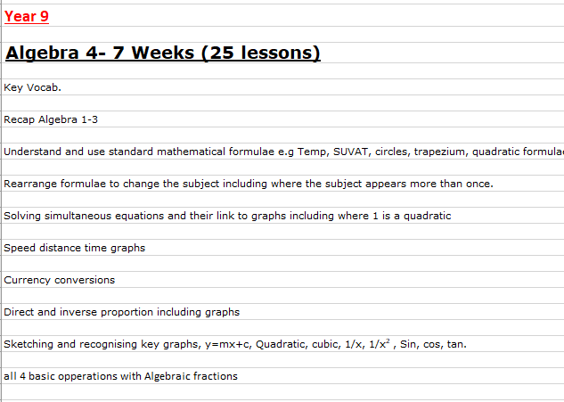
A Half terms content

Slide 10
ASSESSMENT
Pre test
Post test
PLC
To set a baseline
Students will not do well!
To show progress
Students have been taught topics
And now should be able to answer
The questions!
Students know their gaps
Students can independently
Work on their
weaknesses

Slide 11
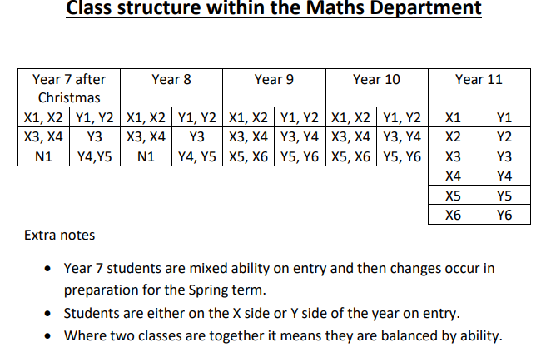
Setting

Slide 12
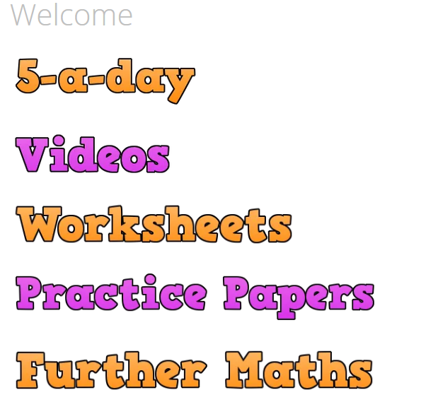
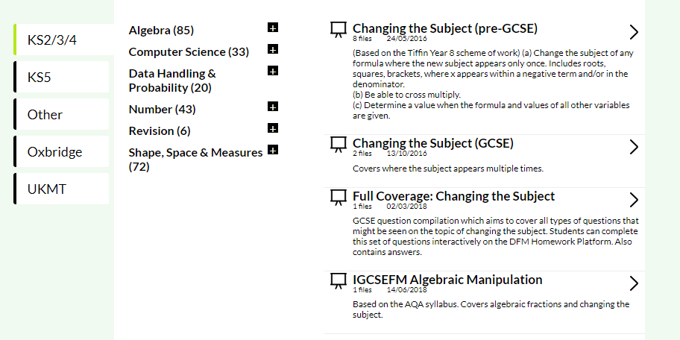
Resources
https://corbettmaths.com/
https://www.drfrostmaths.com/resources-browse.php?tid=39#

Slide 13
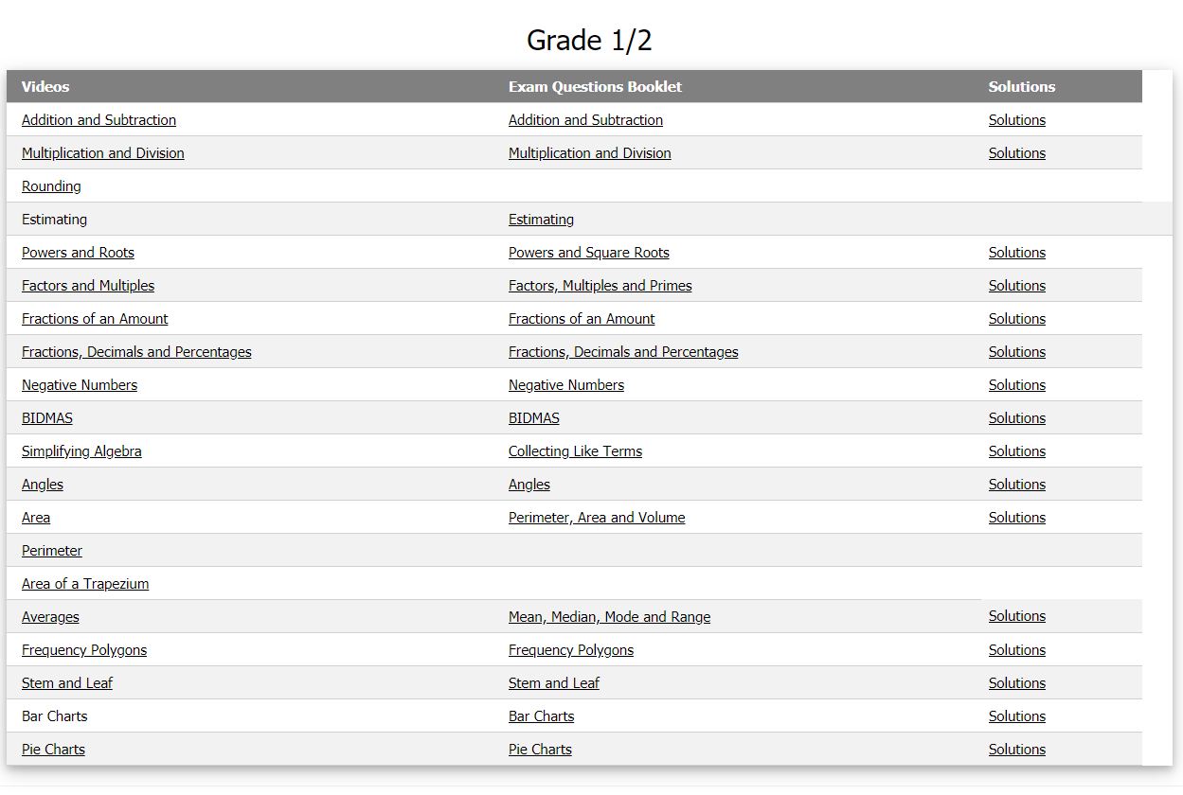
Resources
https://www.mathsgenie.co.uk/gcse.html

Slide 14
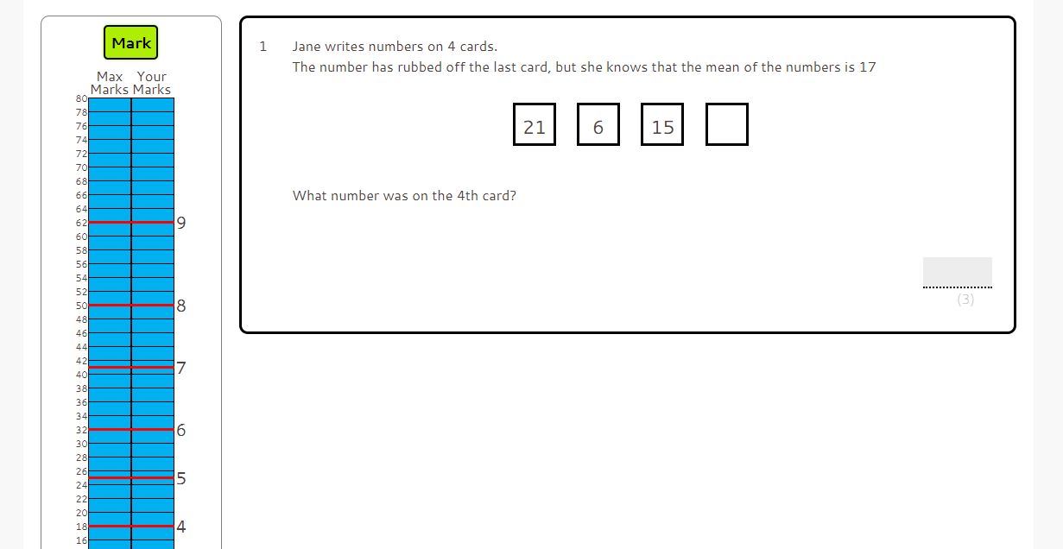
Resources
https://www.onmaths.com/

Slide 15
The exam structure
Paper 1: Non calc
1.5 hours
Paper 2: Calc
1.5 hours
Paper 3: Calc
1.5 hours
The course: AQA 8300
Tiers:
Foundation (Grades 1 to 5) or Higher (Grades 3 to 9)
No coursework
Calculator:
The must own their own, so they can get used to it and know how to use it well in advance of the exam

Slide 16
Exam technique
Paper 1: Non calc
1.5 hours
Paper 2: Calc
1.5 hours
Paper 3: Calc
1.5 hours
Paper 1: students lose marks on calculations without a calculator (loss of average 10 marks)
Calculator:
The must own their own, so they can get used to it and know how to use it well in advance of the exam
Paper 3: paper fatigue sets in (loss of average 10 marks)

