Slide 1

KS4 Success Evening
Year 11

Slide 2
So what’s it all about?
How to revise effectively
What can YOU do as parents?
The new grading system
Exams, timetable, structure and expectations
The Future

Slide 3

How to revise effectively – Miss Nightingale
I’ve been here for hours and I still don’t understand it fully.
This is not going in!
Do you think your students ever feel like this?

Slide 4
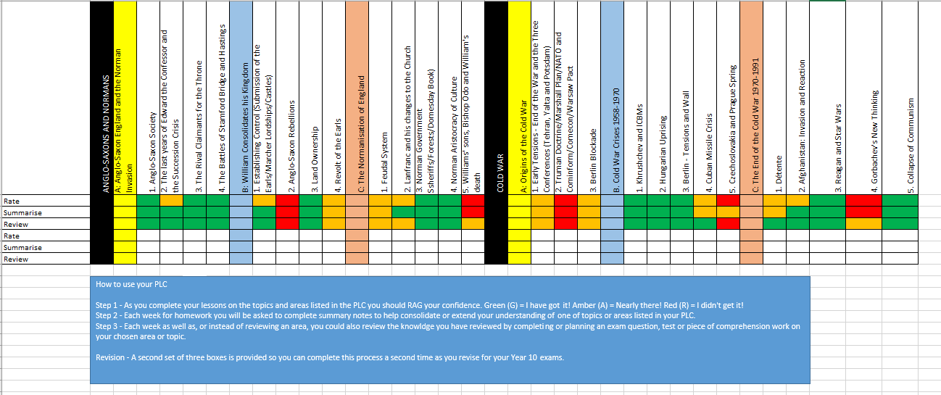
Personalised Learning Checklists (PLCs)

Slide 5
Knowledge vs. familiarity
How well do you know the £10 note? You have seen it thousands of times, so you should know all about it.
Think about the front of a £10 note (not the side with the Queen’s head).
Who’s on it?

Slide 6
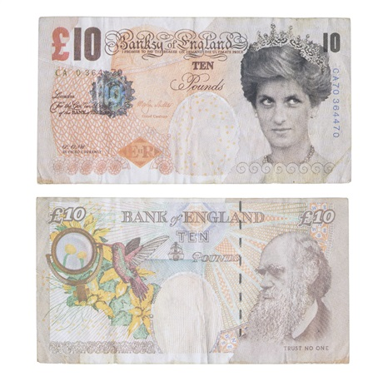
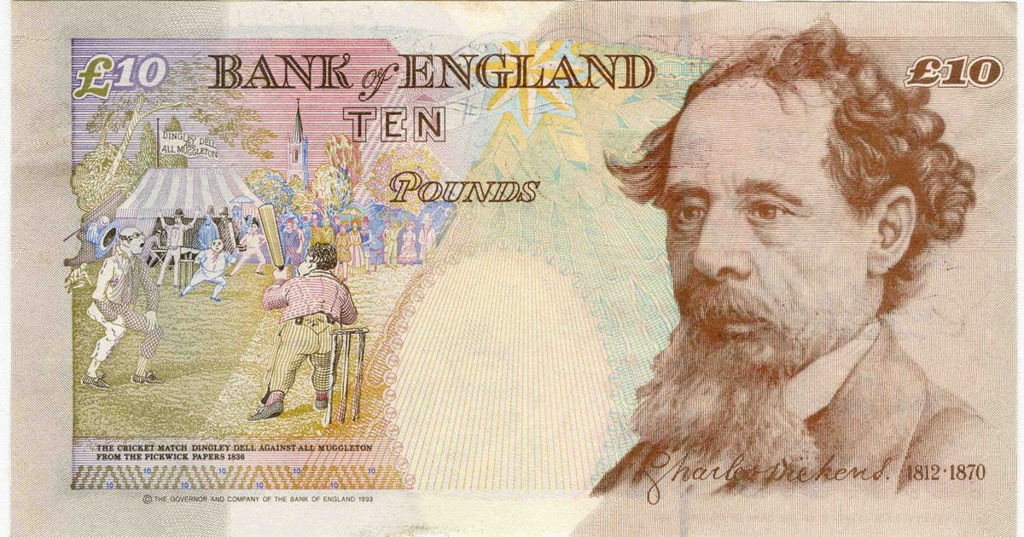
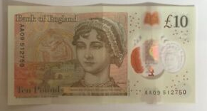
We have seen the note many times (‘shallow repetition’) but we have not thought about it. Therefore we are familiar with it but we do not know it!

Slide 7
Knowledge vs. familiarity
So what colour are the following notes:
£5
£10
£20
£50
Why are we more likely to remember these?
Have to think about it!

Slide 8
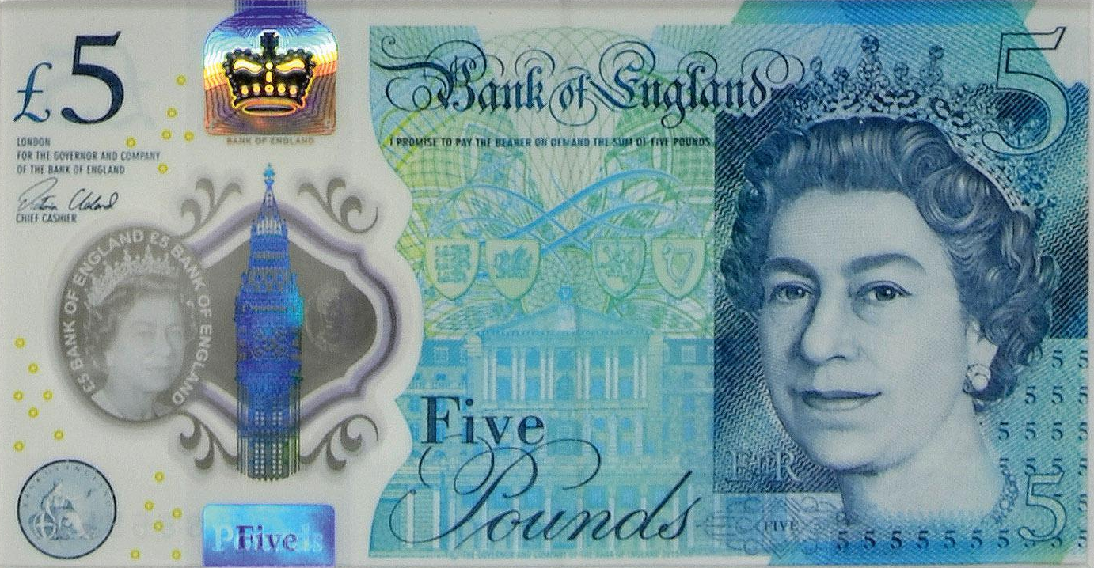
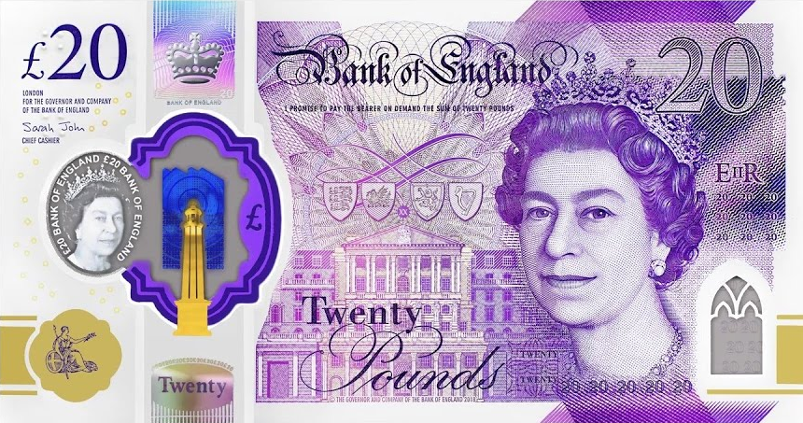
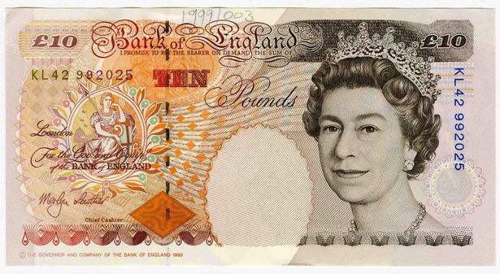
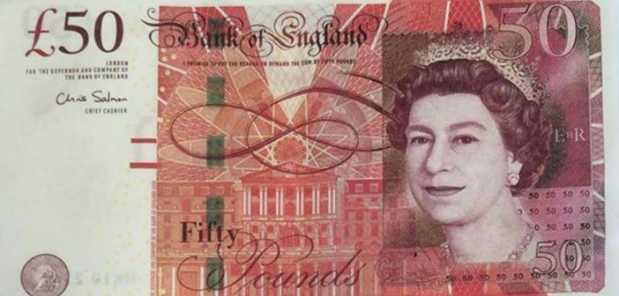

Slide 9
“Learning happens when people have to think hard”
Prof. Robert Coe – Durham University
Notes:
http://www.cem.org/attachments/publications/ImprovingEducation201

Slide 10

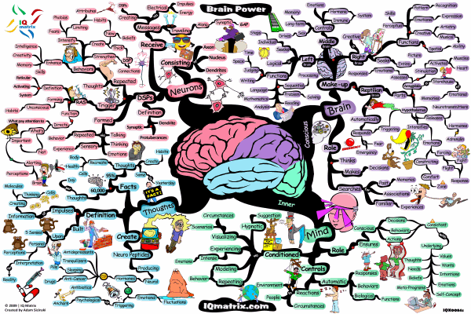
We need to engage in higher-order thinking
if knowledge is going to go into the long-term memory

Slide 11


Re-visit
1.
2.
Upload
KNOWLEDGE
Process
KNOWLEDGE
3.
Download
KNOWLEDGE
Better Future – Brighter Hope

Slide 12

Re-visit
Upload
Process
Download
CHUNK
IT
TRANSFORM
IT
RESTORE IT
RE-LEARN-IT
REDUCE IT
IT
STEP IT
WRITE IT
TEST IT
SORT IT
SPEAK IT
LINK IT
REFINE IT
Better Future – Brighter Hope

Slide 13
Re-visit
Upload
CHUNK
IT
RE-LEARN
IT
WRITE
IT
SPEAK
IT
Re-read your notes on the chosen topic.
Do some wider research on the internet until you understand it.
Use: Thinkit/Graspit/Knowit
Independence
Apps etc.
Split the Thinkit into manageable chunks.
Choose a chunk at a time to memorise.
Start with the most important or the most difficult.
Write a detailed description or an explanation about everything you
know about this topic. Try to do this without your notes.
Topic on a page
Write key facts you need to memorise
over and over until you have memorised them.
Give a verbal explanation about this topic as if you were teaching it.
Repeat facts you need to remember 20 times.
Record key facts about this topic onto your phone.
Say what you’ve learnt from memory, using the Thinkit images to prompt you.
-
Better Future – Brighter Hope

Slide 14

Re-visit
Process
Transform
IT
REDUCE
IT
SORT
IT
LINK
IT
Reduce what you have learnt about this topic into 5 bullet points or prompts.
Reduce the 3 most important facts in this topic into 9 words.
Use the ranking template to rank the most important facts from this topic.
What is the most difficult point to remember? Why?
Categorise key facts from this topic into 3 groups. You choose the group headings.
Find 3 links between this topic and other topics you have studied.
Link the points together.
Link the ideas.
Find some Radom links.
Link the factors.
Transform key facts into ia series of images.
Transform what you have learnt into a diagram.
Transform your learning into a poem or a story.
Better Future – Brighter Hope
Notes:
W

Slide 15
Re-visit
Download
REFINE
IT
RESTORE
IT
STEP
IT
TEST
IT
Go back to your Reduce it bullet points. Restore them to their original state.
Go back to your images and restore them back into written form..
Create a 5 step process explaining the 3 most difficult learning points here.
Recall the process or order of events you have studied
Use the Thinkit images to test your knowledge.
Write yourself 3-5 exam questions on this topic or skill.
Improve it
Rank it
Reorder it
Change it
Condense it
Add to it
What have you missed out from your topic on a page?
-
Better Future – Brighter Hope

Slide 16
Re-visit
Upload
CHUNK
IT
RE-LEARN
IT
WRITE
IT
SPEAK
IT
Re-read your notes on the chosen topic.
Do some wider research on the internet until you understand it.
Use: Thinkit/Graspit/Knowit
Independence
Apps etc.
Split the Thinkit into manageable chunks.
Choose a chunk at a time to memorise.
Start with the most important or the most difficult.
Write a detailed description or an explanation about everything you
know about this topic. Try to do this without your notes.
Topic on a page
Write key facts you need to memorise
over and over until you have memorised them.
Give a verbal explanation about this topic as if you were teaching it.
Repeat facts you need to remember 20 times.
Record key facts about this topic onto your phone.
Say what you’ve learnt from memory, using the Thinkit images to prompt you.
-
Better Future – Brighter Hope

Slide 17

Re-visit
Process
Transform
IT
REDUCE
IT
SORT
IT
LINK
IT
Reduce what you have learnt about this topic into 5 bullet points or prompts.
Reduce the 3 most important facts in this topic into 9 words.
Use the ranking template to rank the most important facts from this topic.
What is the most difficult point to remember? Why?
Categorise key facts from this topic into 3 groups. You choose the group headings.
Find 3 links between this topic and other topics you have studied.
Link the points together.
Link the ideas.
Find some Radom links.
Link the factors.
Transform key facts into ia series of images.
Transform what you have learnt into a diagram.
Transform your learning into a poem or a story.
Better Future – Brighter Hope
Notes:
W

Slide 18
Transform activity – The effects of a gas attack
Chlorine gas was first used by the Germans in 1915 as the second Battle of Ypres. It led to death by suffocation. The medical service had no experience in dealing with gas attacks, and so had to experiment with treatments.
Gas masks were given to all British troops in July 1915.
Before this soldiers developed their own system of gas masks. They soaked cotton pads with urine and pressed them to their faces to help stop the gas entering their lungs.
The British retaliated with their own chlorine attack later in 1915 at the Battle of Loos, but the wind changed direction and the gas blew back on the British lines.

Slide 20
Deconstruct: Make a large amount of learning manageable.
Star Wars – A New Hope
Belief
Narrative
Family
Protagonists
Sith
B
Prop D
Structuralist
F
Father
G
Leia
L
The Force
A
Sister
H
Han Solo
J
Enigma
E
Jedi
C
Luke Skywalker
K
Friendship
I
Notes:
Taken from the article: ‘What Will Improve a Student’s Memory?’ By Daniel T Willingham
http://www.aft.org/sites/default/files/periodicals/willingham_0.pdf

Slide 22
Re-visit
Download
REFINE
IT
RESTORE
IT
STEP
IT
TEST
IT
Go back to your work - Reduce it to bullet points. Restore them to their original state.
Go back to your images and restore them back into written form..
Create a 5 step process explaining the 3 most difficult learning points here.
Recall the process or order of events you have studied
Use the Thinkit images to test your knowledge.
Write yourself 3-5 exam questions on this topic or skill.
Improve it
Rank it
Reorder it
Change it
Condense it
Add to it
What have you missed out from your topic on a page?
-
Better Future – Brighter Hope

Slide 23

Top 10 tips to support your child through their exams

Slide 24

1. Being a role model
Set a good example by modelling the behaviour you want your child to adopt…
Planning for the week
Eating healthily and well
Keeping hydrated
Leading an active life
Staying calm
Being organised
Good sleep habits

Slide 25

2. Goal Setting
Encourage them to keep their goals planner visible – e.g. printed and displayed on their bedroom wall
Help focus them and talk to them about their goals regularly
Give positive reinforcement
Connect with them about ‘why’ and ‘what’ they want to achieve

Slide 26

60 minutes per day
3. Keeping Active
Encourage them to keep active on a daily basis
Carry out exercise in manageable chunks e.g. 3 x 20 min sessions throughout the day
Plan to do active things together on a weekend
Go out for a walk together and get some fresh air
Help them plan out their weekly exercise schedule in advance
After exercise your brain functions well, so encourage a revision session afterwards

Slide 27

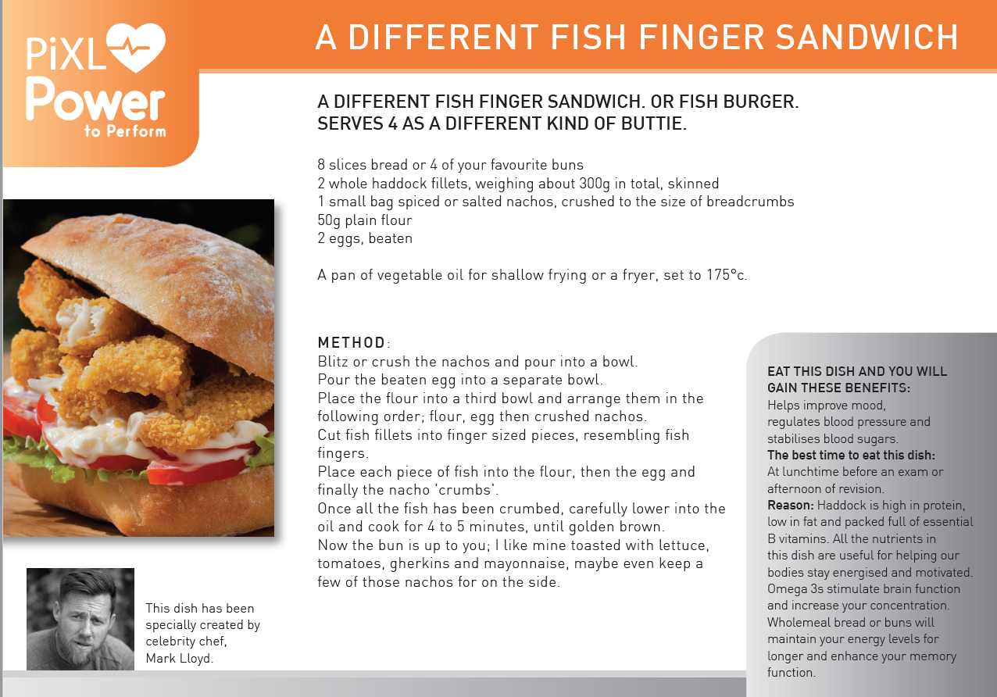
4. Healthy Eating
Plan your family meals for the week – breakfast, snacks, lunches and evening meals
Carry out a weekly food shop and make sure you write a list
Avoid high sugary and fatty foods or drinks
Aim to eat clean, fresh and healthy foods
Have a couple or ‘treat’ meals / or meals out per week
Use the Mark Lloyd recipes and meal planner as guidance
Encourage them to eat breakfast everyday
Hydration is key to brain functioning so make sure your child carries a bottle of water with them

Slide 28


5. Time Out
Encourage them to build in opportunities to take some time out every week, away from study. For example:
Going out for food
Seeing friends
Having a bath
Listening to music
Reading a book
Doing a hobby
Going shopping
Going to the cinema

Slide 29

6.Sleep Patterns
Young people need between 8 – 9 hours sleep per night
Help your child create a relaxing evening routine
Make sure they don’t eat too late at night
Avoid giving them caffeine or sugary drinks late at night
Make sure they don’t work or revise too late before going to bed
Encourage them to switch off from social media / technology at least an hour before bedtime

Slide 30

7. Unplugging
Encourage them to unplug from technology everyday
Help them switch off from technology at least 30 mins- 1 hr before going to sleep
Support your child to appreciate the world around them rather than being governed by their phone
Make sure they put their phone away, & on silent, while they are concentrating on tasks / revision / homework
Help them learn to have the control to not be obsessed with their phone
Choose some time each day/week to switch off and unplug from technology with them

Slide 31


8. Staying Cool & Calm
Set a good example by staying calm yourself
Create a relaxing environment for your child
Help them plan out coping strategies to deal with their stress
Give them positive distractions away from studying
Help them understand their stress & to focus on controlling the controllables
Promote a balance of their academic studies & other activities during the week

Slide 32


9. Belief
Give them positive reinforcement
Boost their confidence daily
Celebrate any successes and reward them e.g. if they have achieved their mini-goals
Try not to set your expectations too high
Show them how proud of them you are
Highlight things to make them feel good
Give them the belief in themselves to help them achieve

Slide 33

10. Be Supportive
Be a good listener
Be approachable
Encourage them to take breaks in between revision
Show some understanding of what they are going through
Help them deal with their emotions & feelings
Offer caring advice
Just be there for them!

Slide 34



Slide 35


Slide 36
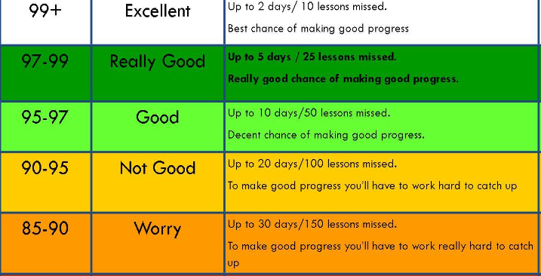

Slide 37
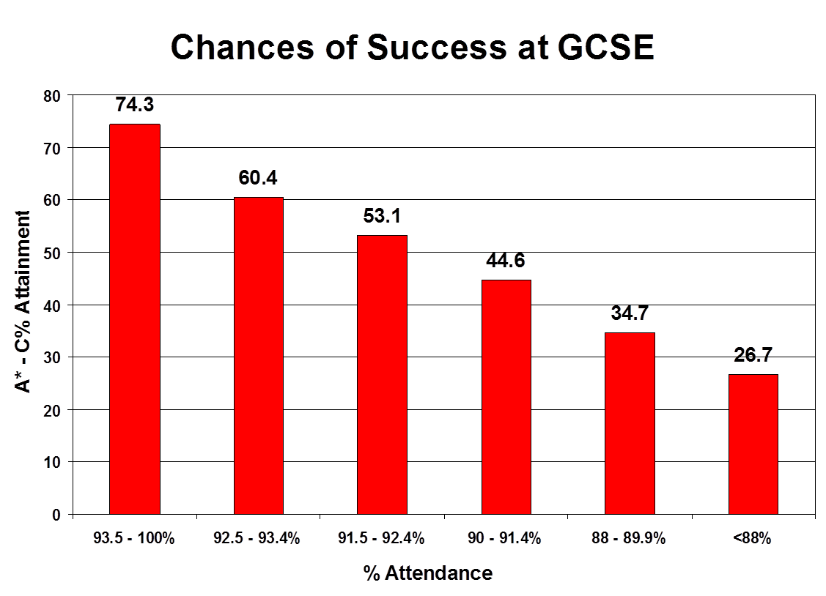
% of the attainment of 5 Level 4 and above

Slide 38


Slide 39

What is available in school?
Mentoring for specific students
After school interventions:
English & Maths (there are many more)
Nightclub every Tuesday, Wednesday and Thursday from 3:30-5:30pm
Study Zone in the Library at lunchtimes

Slide 40
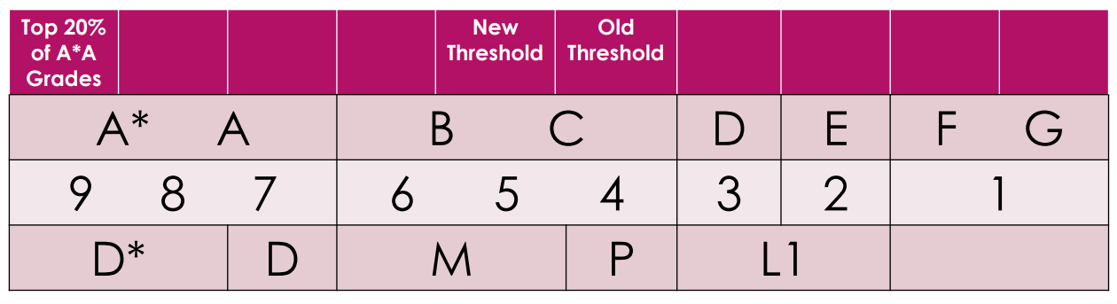
The new grading system

Slide 41
Year 11 Trial Exam Season 1 2019
Date | Periods 1 & 2 | Break | Periods 3 & 4 | Lunch | Period 5
Monday 18 November | Astronomy Drama | Break | German Listening | Lunch | Geography: Natural World
Tuesday 19 November | Maths P1 | Break |  | Lunch | DT
Wednesday 20 November | Biology Combined Science Biology | Break |  | Lunch | Business CNAT Enterprise & Marketing
Thursday 21 November | PE Music | Break | Spanish Listening | Lunch | I-Media
Friday 22 November | English Language | Break | French Listening | Lunch | Geography People & Society

Slide 42
Year 11 Trial Exam Season 1 2019
Date | Periods 1 & 2 | Break | Periods 3 & 4 | Lunch | Period 5
Monday 25 November | Maths P2 | Break | MFL Reading French German Spanish | Lunch | MFL Writing French German Spanish
Tuesday 26 November | Chemistry Combined Science Chemistry | Break |  | Lunch | PE Music BTEC
Wednesday 27 November | Physics Combined Science Physics | Break |  | Lunch | Maths P3
Thursday 28 November | English Language Writers Viewpoints | Break |  | Lunch | Hospitality & Catering
Friday 29 November | History Anglo & Cold War American West | Break |  | Lunch | Geography Geographical Exploration P3

Slide 43
Get organised!

Slide 44


Slide 45
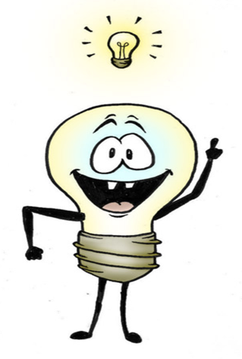
Your Choices after Yr 11
Sixth Form – in a School (Hbk)
College of Further Education (CRC)
Apprenticeship – L2 or L3
Job with training
Traineeship
Foundation Learning

Slide 46

Depends on?
Your GRADES – 5 x 5s inc Maths/Eng/Sci for Hbk
Your interests – you will do better in subjects you ENJOY
Your passions/interests
Your future Career Intentions – esp Medicine
The way you learn best
Do you need a fresh start – new friends/opportunities?

Slide 47


What now?
Do the research
Speak with your family/friends/carers
Speak with your Tutor
Speak with a Careers Advisor

