Slide 1

KS4 Success Evening
Year 9/10

Slide 2
So what’s it all about?
How to revise effectively
What can YOU do as parents?
The new grading system
Exams, timetable, structure and expectations

Slide 3

How to revise effectively – Miss Nightingale
I’ve been here for hours and I still don’t understand it fully.
This is not going in!
Do you think your students ever feel like this?

Slide 4
Knowledge vs. familiarity
How well do you know the 50p coin? You have seen it thousands of times, so you should know all about it.
Think about the front of a 50p coin (not the side with the Queen’s head). There is an image of Britannia.
  What is in her left hand?
  What is in her right hand?
  What is on the shield?
  What is on her head?
  What is at her feet?

Slide 5

We have seen the coin many times (‘shallow repetition’) but we have not thought about it. Therefore we are familiar with it but we do not know it!

Slide 6
“Learning happens when people have to think hard”
Prof. Robert Coe – Durham University
Notes:
http://www.cem.org/attachments/publications/ImprovingEducation201

Slide 7

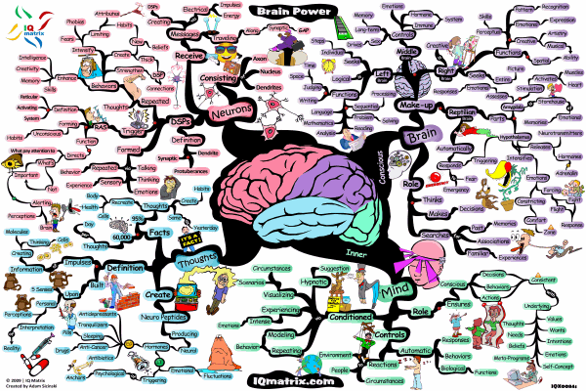
We need to engage in higher-order thinking
if knowledge is going to go into the long-term memory

Slide 8


Re-visit
1.
2.
Upload
KNOWLEDGE
Process
KNOWLEDGE
3.
Download
KNOWLEDGE
Better Future – Brighter Hope

Slide 9



Re-visit
Upload
Process
Download
CHUNK
IT
TRANSFORM
IT
RESTORE IT
RE-LEARN-IT
REDUCE IT
IT
STEP IT
WRITE IT
TEST IT
SORT IT
SPEAK IT
LINK IT
REFINE IT
Better Future – Brighter Hope

Slide 10
Re-visit
Upload
CHUNK
IT
RE-LEARN
IT
WRITE
IT
SPEAK
IT
Re-read your notes on the chosen topic.
Do some wider research on the internet until you understand it.
Use: Thinkit/Graspit/Knowit
Independence
Apps etc.
Split the Thinkit into manageable chunks.
Choose a chunk at a time to memorise.
Start with the most important or the most difficult.
Write a detailed description or an explanation about everything you
know about this topic. Try to do this without your notes.
Topic on a page
Write key facts you need to memorise
over and over until you have memorised them.
Give a verbal explanation about this topic as if you were teaching it.
Repeat facts you need to remember 20 times.
Record key facts about this topic onto your phone.
Say what you’ve learnt from memory, using the Thinkit images to prompt you.
-
Better Future – Brighter Hope

Slide 11

Re-visit
Process
Transform
IT
REDUCE
IT
SORT
IT
LINK
IT
Reduce what you have learnt about this topic into 5 bullet points or prompts.
Reduce the 3 most important facts in this topic into 9 words.
Use the ranking template to rank the most important facts from this topic.
What is the most difficult point to remember? Why?
Categorise key facts from this topic into 3 groups. You choose the group headings.
Find 3 links between this topic and other topics you have studied.
Link the points together.
Link the ideas.
Find some Radom links.
Link the factors.
Transform key facts into ia series of images.
Transform what you have learnt into a diagram.
Transform your learning into a poem or a story.
Better Future – Brighter Hope
Notes:
W

Slide 12
Transform activity – first visit to Miss Havisham Chapter 8 Great Expectations by Charles Dickens
She was dressed in rich materials - satins, and lace, and silks - all of white. Her shoes were white. And she had a long white veil dependent from her hair, and she had bridal flowers in her hair, but her hair was white. Some bright jewels sparkled on her neck and on her hands, and some other jewels lay sparkling on the table. Dresses, less splendid than the dress she wore, and half-packed trunks, were scattered about. She had not quite finished dressing, for she had but one shoe on - the other was on the table near her hand - her veil was but half arranged, her watch and chain were not put on…..

Slide 14
Deconstruct: Make a large amount of learning manageable.
Star Wars – A New Hope
Belief
Narrative
Family
Protagonists
Sith
B
Prop D
Structuralist
F
Father
G
Leia
L
The Force
A
Sister
H
Han Solo
J
Enigma
E
Jedi
C
Luke Skywalker
K
Friendship
I
Notes:
Taken from the article: ‘What Will Improve a Student’s Memory?’ By Daniel T Willingham
http://www.aft.org/sites/default/files/periodicals/willingham_0.pdf

Slide 16
Re-visit
Download
REFINE
IT
RESTORE
IT
STEP
IT
TEST
IT
Go back to your Reduce it bullet points. Restore them to their original state.
Go back to your images and restore them back into written form..
Create a 5 step process explaining the 3 most difficult learning points here.
Recall the process or order of events you have studied
Use the Thinkit images to test your knowledge.
Write yourself 3-5 exam questions on this topic or skill.
Improve it
Rank it
Reorder it
Change it
Condense it
Add to it
What have you missed out from your topic on a page?
-
Better Future – Brighter Hope

Slide 17

Head of Year 10 – Mrs Nichols
Top 10 tips to support your child through their exams

Slide 18

What is Prepare to Perform?
Staying calm, feeling good, being effective
A toolkit to help your child control different aspects of their life to help them perform better when it comes to exam time
It will allow them to focus, set themselves a plan and work towards being prepared in the best possible way

Slide 19

How can you help your child
and prepare them to perform?
Being a role model
Help them set goals
Keep them active
Healthy eating
Time out
Sleep patterns
Unplugging
Staying cool & calm
Belief
Be supportive
Each day you can support your child to make choices which can impact how they perform during the exam period

Slide 20

1. Being a role model
Set a good example by modelling the behaviour you want your child to adopt…
Planning for the week
Eating healthily and well
Keeping hydrated
Leading an active life
Staying calm
Being organised
Good sleep habits

Slide 21

2. Goal Setting
Encourage them to keep their goals planner visible – e.g. printed and displayed on their bedroom wall
Help focus them and talk to them about their goals regularly
Give positive reinforcement
Connect with them about ‘why’ and ‘what’ they want to achieve

Slide 22

60 minutes per day
3. Keeping Active
Encourage them to keep active on a daily basis
Carry out exercise in manageable chunks e.g. 3 x 20 min sessions throughout the day
Plan to do active things together on a weekend
Go out for a walk together and get some fresh air
Help them plan out their weekly exercise schedule in advance
After exercise your brain functions well, so encourage a revision session afterwards

Slide 23

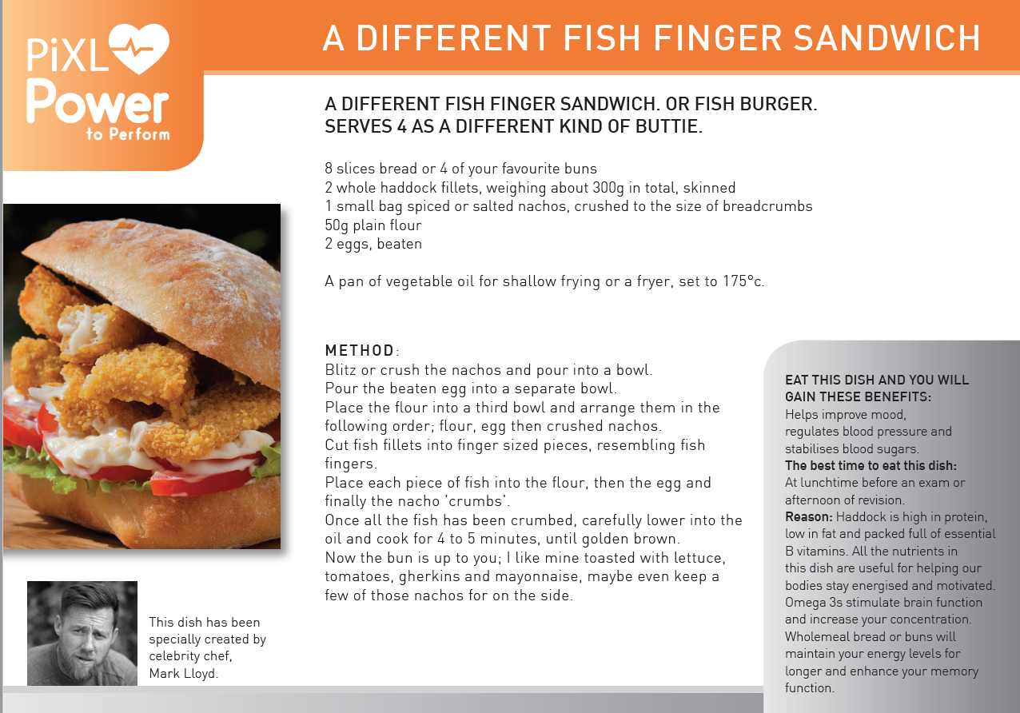
4. Healthy Eating
Plan your family meals for the week – breakfast, snacks, lunches and evening meals
Carry out a weekly food shop and make sure you write a list
Avoid high sugary and fatty foods or drinks
Aim to eat clean, fresh and healthy foods
Have a couple or ‘treat’ meals / or meals out per week
Use the Mark Lloyd recipes and meal planner as guidance
Encourage them to eat breakfast everyday
Hydration is key to brain functioning so make sure your child carries a bottle of water with them

Slide 24


5. Time Out
Encourage them to build in opportunities to take some time out every week, away from study. For example:
Going out for food
Seeing friends
Having a bath
Listening to music
Reading a book
Doing a hobby
Going shopping
Going to the cinema

Slide 25

6.Sleep Patterns
Young people need between 8 – 9 hours sleep per night
Help your child create a relaxing evening routine
Make sure they don’t eat too late at night
Avoid giving them caffeine or sugary drinks late at night
Make sure they don’t work or revise too late before going to bed
Encourage them to switch off from social media / technology at least an hour before bedtime

Slide 26

7. Unplugging
Encourage them to unplug from technology everyday
Help them switch off from technology at least 30 mins- 1 hr before going to sleep
Support your child to appreciate the world around them rather than being governed by their phone
Make sure they put their phone away, & on silent, while they are concentrating on tasks / revision / homework
Help them learn to have the control to not be obsessed with their phone
Choose some time each day/week to switch off and unplug from technology with them

Slide 27


8. Staying Cool & Calm
Set a good example by staying calm yourself
Create a relaxing environment for your child
Help them plan out coping strategies to deal with their stress
Give them positive distractions away from studying
Help them understand their stress & to focus on controlling the controllables
Promote a balance of their academic studies & other activities during the week

Slide 28


9. Belief
Give them positive reinforcement
Boost their confidence daily
Celebrate any successes and reward them e.g. if they have achieved their mini-goals
Try not to set your expectations too high
Show them how proud of them you are
Highlight things to make them feel good
Give them the belief in themselves to help them achieve

Slide 29

10. Be Supportive
Be a good listener
Be approachable
Encourage them to take breaks in between revision
Show some understanding of what they are going through
Help them deal with their emotions & feelings
Offer caring advice
Just be there for them!

Slide 30



Slide 31


Slide 32
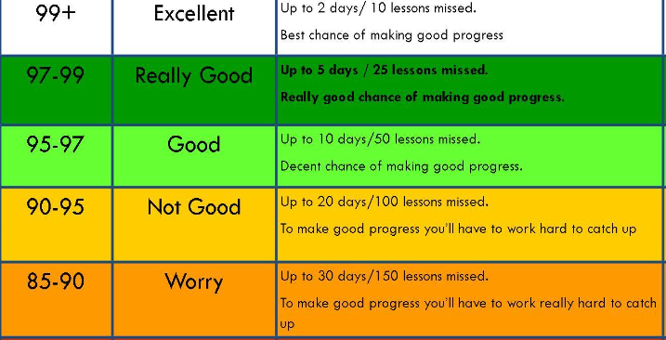

Slide 33
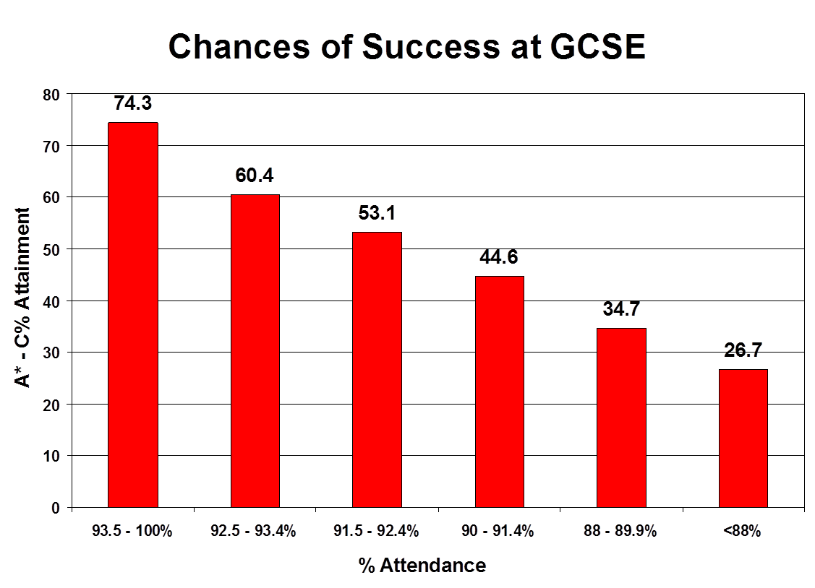
% of the attainment of 5 Level 4 and above

Slide 34


Slide 35
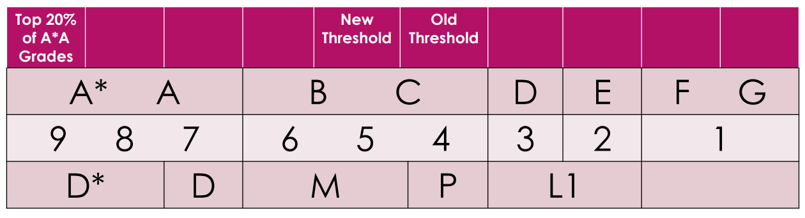
The new grading system

Slide 36

Help on the school website
Click on the parents tab
https://www.hinchingbrookeschool.net/

Slide 37
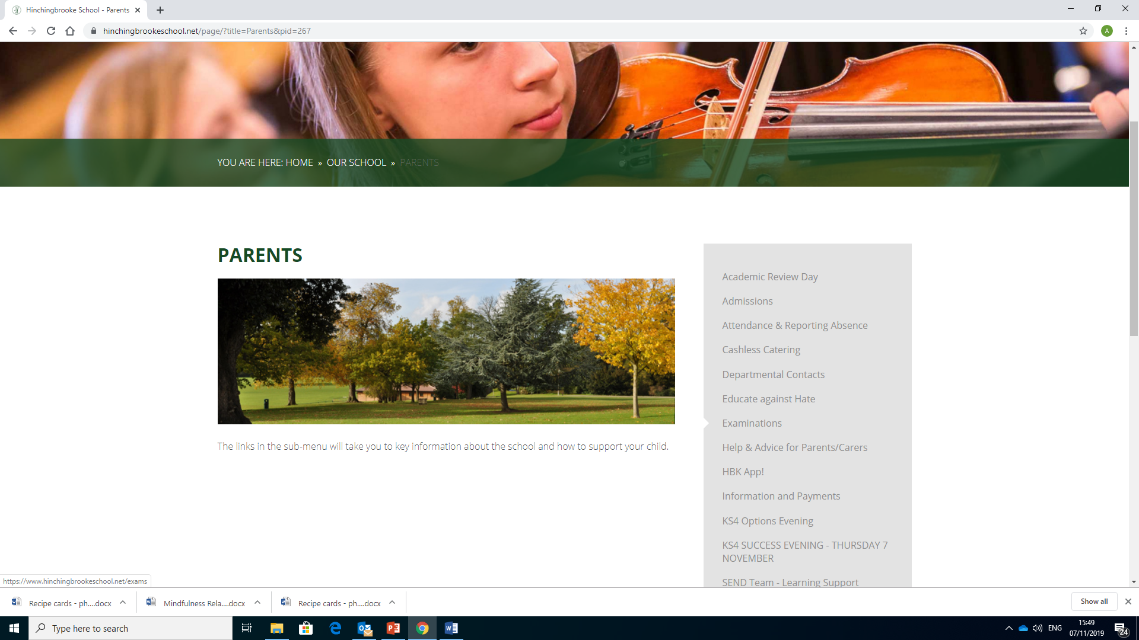
Help on the school website
Click on examinations

Slide 38
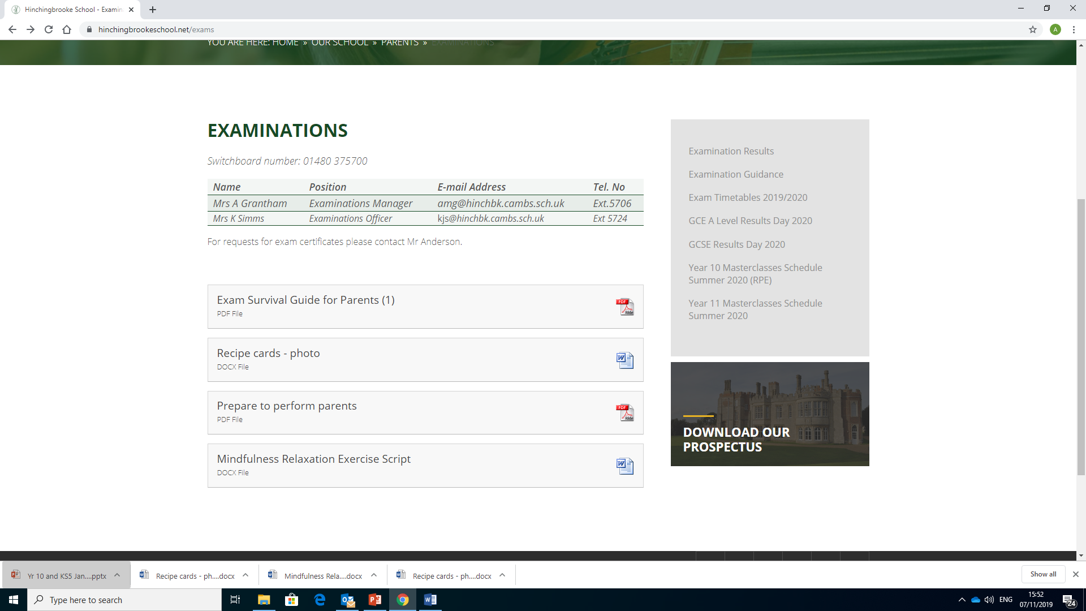
Help on the school website

Slide 39
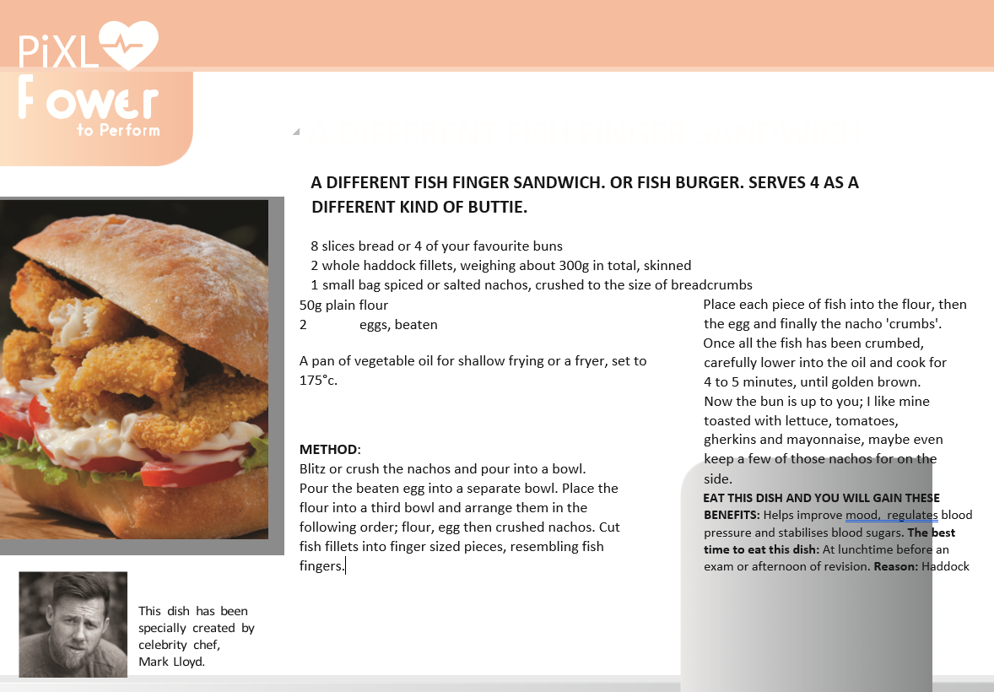
Help on the school website
Recipe cards for food to feed the brain!

Slide 40
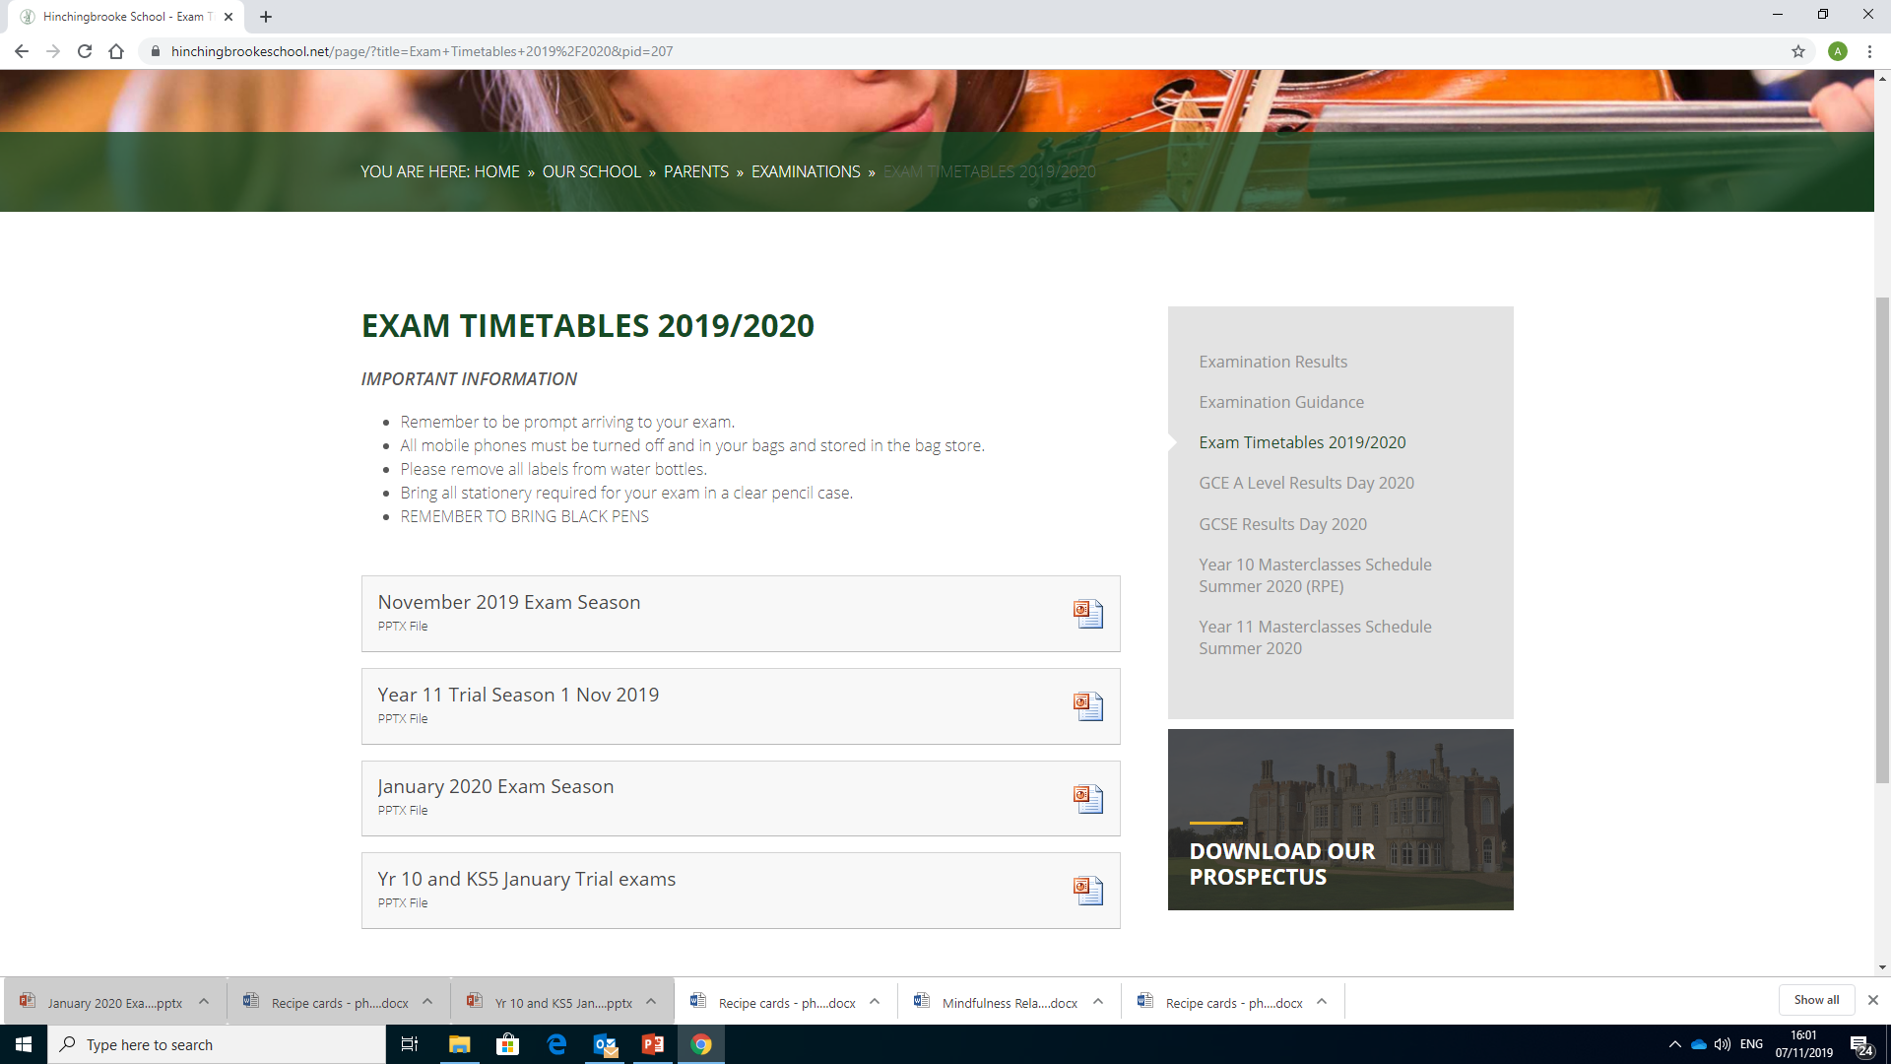
Help on the school website
Exam timetables

