Slide 1
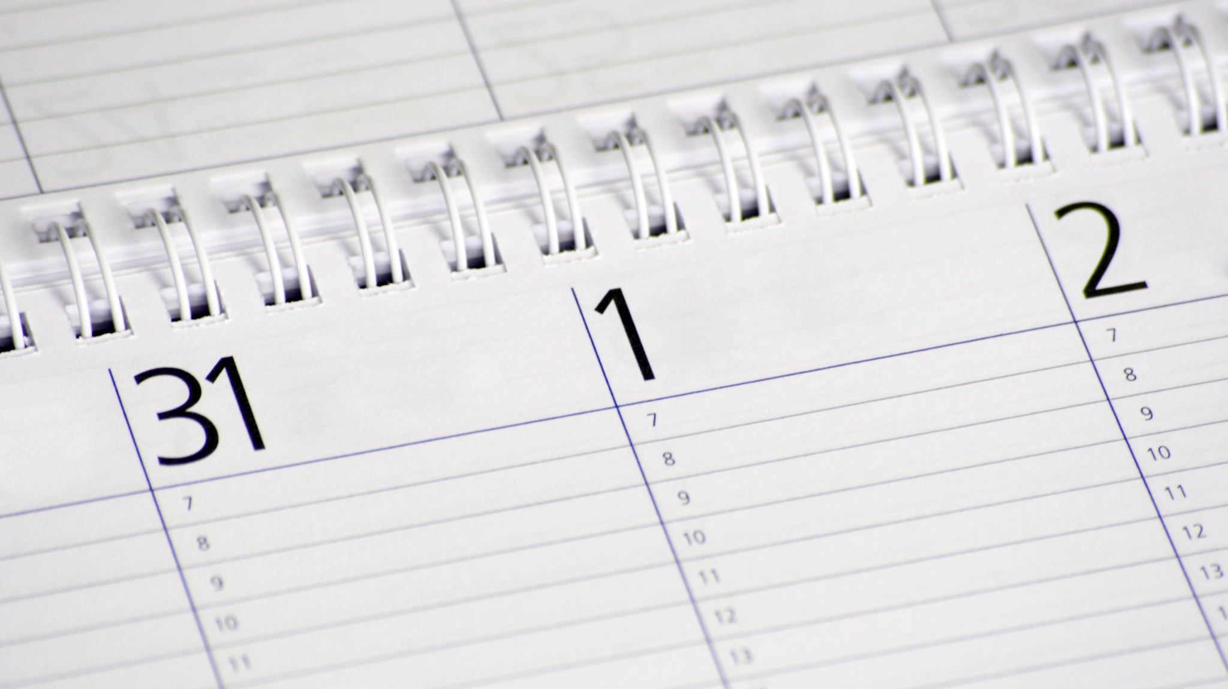
Year 12 Summer Exam Timetable 2025

Slide 2
Week | Morning Exams | Afternoon Exams
Monday 16th June | French Writing (60 mins) Spanish Writing (60 mins) | Maths Paper 1 (90 mins)
Tuesday 17th June | Geography Paper 1 (135 mins) Film Studies Paper 1 (150 mins) | Sociology Paper 1 (90 mins) Biology Paper 1 (90 mins)
Wednesday 18th June | History Paper 1 (150 mins) | English Literature Paper 1 (75 mins)
Thursday 19th June | English Language Paper 1 (120 mins) Chemistry Paper 1 (90 mins) | Religious Studies Paper 1 (120 mins) Psychology Paper 1 (120 mins)
Friday 20th June | Politics Paper 1 (90 mins) Music Technology Component 3 (90 mins) | Physics Paper 1 (90 mins) Media Studies Paper 1 (90 mins)

Slide 3
 | Morning Exams | Afternoon Exams
Monday 23rd June | PE Paper 1 (120 mins) Media Studies Paper 2 (90 mins) Further Maths Paper 1 (120 mins) | Sociology Paper 2 (90 mins) Maths Paper 2 (90 mins)
Tuesday 24th June | Biology Paper 2 (90 mins) Design Technology (120 mins) Computing (150 mins) Music (130 mins) | Psychology Paper 2 (60 mins) Film Studies Paper 2 (60 mins)
Wednesday 25th June | English Language Paper 2 (150 mins) Spanish Listening, Reading & Writing (120 mins) | Chemistry Paper 2 (90 mins) English Literature Paper 2 (105 mins)
Thursday 26th June | History Paper 2 (150 mins) French Listening, Reading & Writing (120 mins) | Religious Studies Paper 2 (60 mins) Physics Paper 2 (90 mins)
Friday 27th June | PE Paper 2 (120 mins) Further Maths Paper 2 (120 mins) Music Technology Component 4 (135 mins) Politics Paper 2 Clash (60 mins) | Politics Paper 2 (60 mins) Geography Paper 2 (75 mins)

